Slide 1
Electric Vehicle Infrastructure and Air Quality Initiatives
May 11, 2022
DCTMA Municipalities Conference

Slide 2
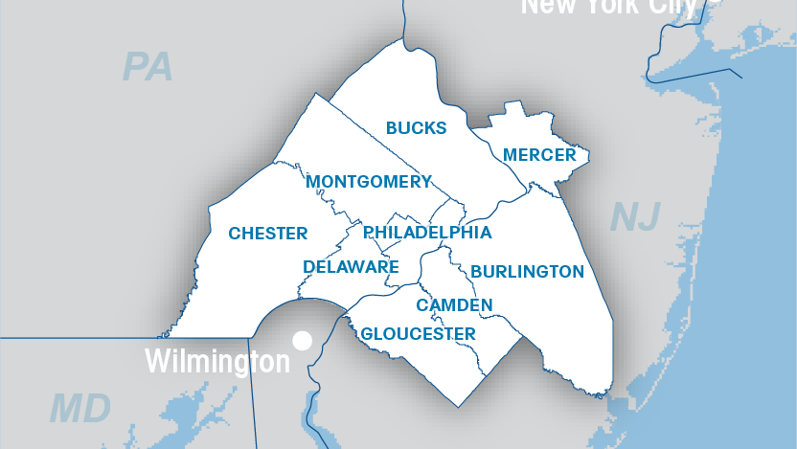
Notes:
MPO’s are federally mandated transportation policy-making organization required for areas with more than 50,000 people in order to access federal funding for transportation projects.
MPO’s core functions:
Provide an impartial setting for regional decision-making.
Evaluate transportation alternatives.
Develop/maintain a long-range transportation plan (LRP).
Develop a transportation improvement program (TIP).
Involve the public in regional decision-making and the development of the LRP and the TIP.
Protect air quality.
DVRPC is the MPO for Greater Philadelphia.
DVRPC Region (the Delaware Valley or Greater Philadelphia) 2 states: Pennsylvania and New Jersey 9 counties: Bucks, Chester, Delaware, Montgomery, and Philadelphia counties in Pennsylvania; and Burlington, Camden, Gloucester, and Mercer in New Jersey 353 municipalities Nearly 2.5 million acres of land
The People 5.5 million population 2.8 million jobs By 2035: 6.1 million population 3.1 million jobs
Federally-designated MPO
for nine-county region in
PA and NJ
Created in 1965 to plan for
“orderly growth and
development”
Transportation, land use,
open space, housing and
economic development
Short, medium and long
term transportation plans
provide funding for projects

Slide 3
Overview
Emissions – Climate Change and Health
Delaware County Air Quality
Strategies for Improvement – Electric Vehicles
Funding
Resources

Slide 4
Pollutants and Emissions
Climate Change – Greenhouse Gases (GHG)
Region is getting warmer and wetter – more days over 90º
Frequency and power of extreme weather events – more precipitation delivered in big storms
Sea-level rise impacts communities on the Delaware River and beyond
Sources of GHGs – Commercial and residential energy use, and transportation

Slide 5
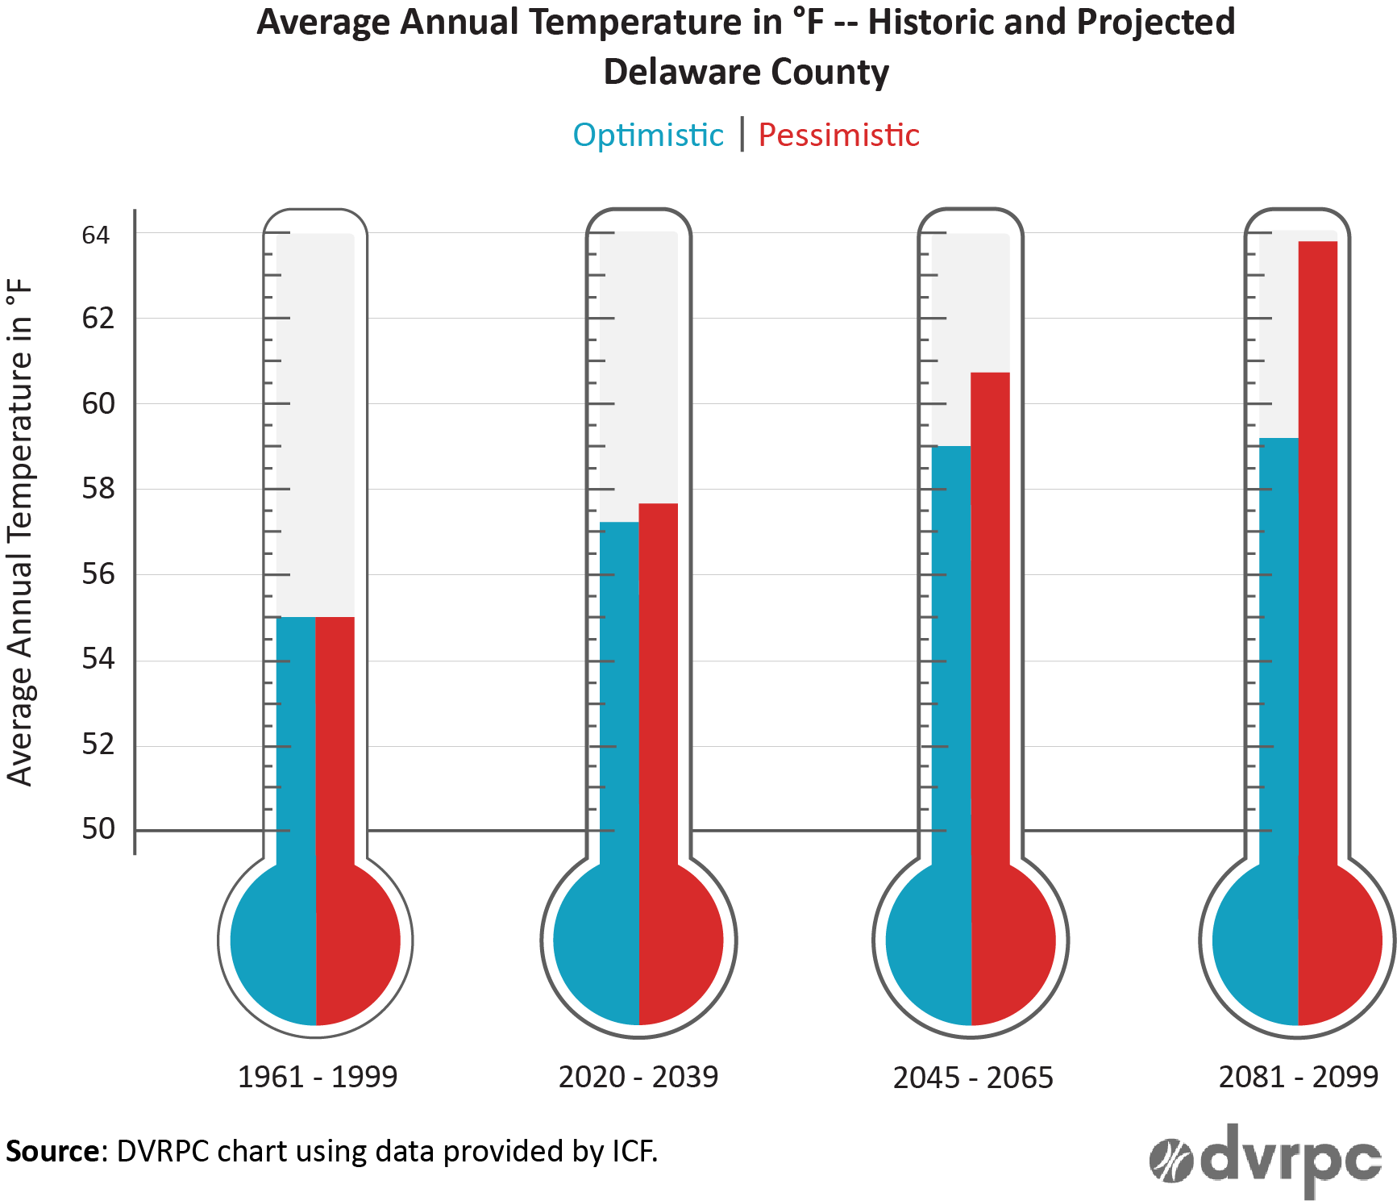
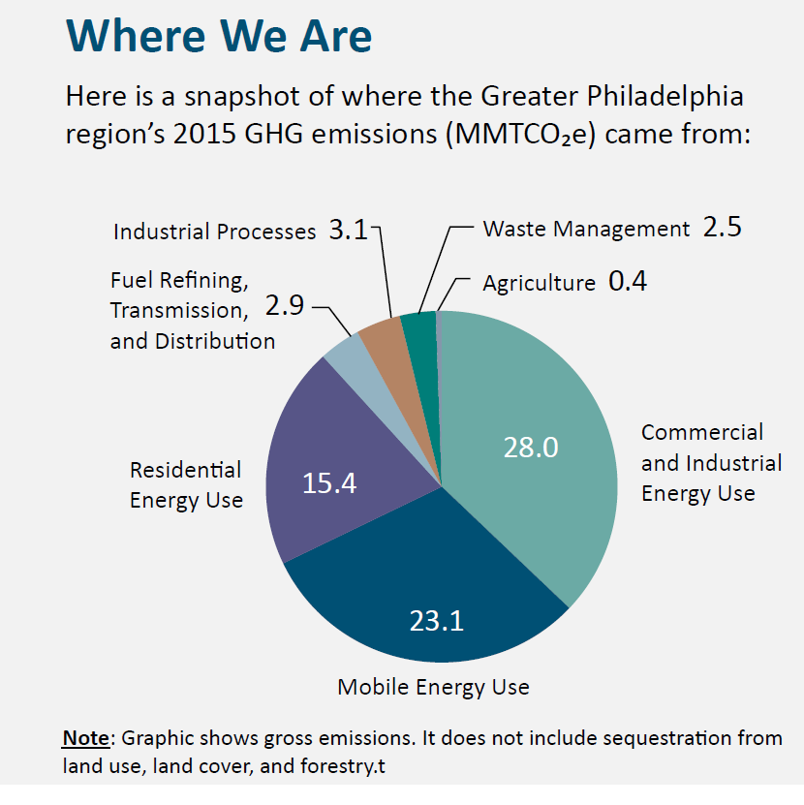
Pollutants and Emissions
Source: DVRPC 2015 GHG Inventory

Slide 6
Pollutants and Emissions
Criteria Pollutants – Ozone and PM_{2.5}
Impact cardio-vascular health
Lung damage, heart damage, early death, more susceptible to infection
Sources of criteria pollutants – energy generation, industry, and transportation
On-road mobile sources – cars, trucks, buses
Accounts for 38% NO_{x}, 14% VOC, 3% PM_{2.5}
Combine to form Ozone
Source: FHWA Transportation Air Quality Selected Facts and Figures

Slide 7
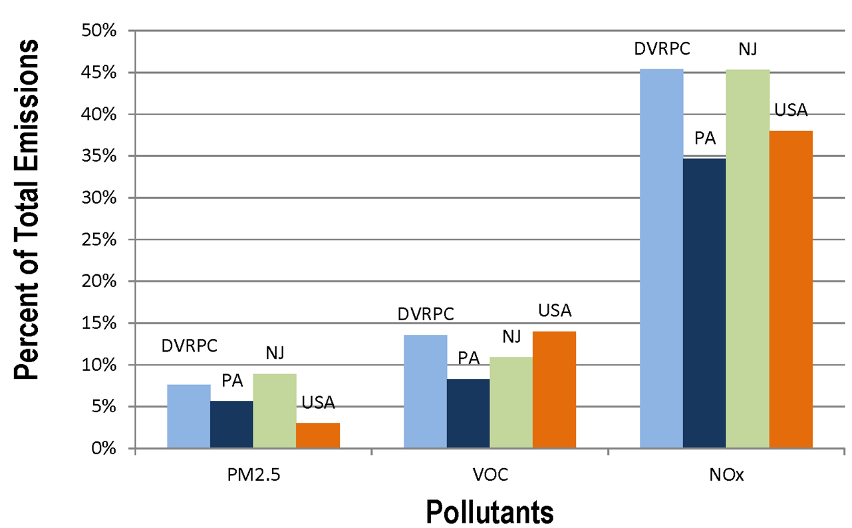
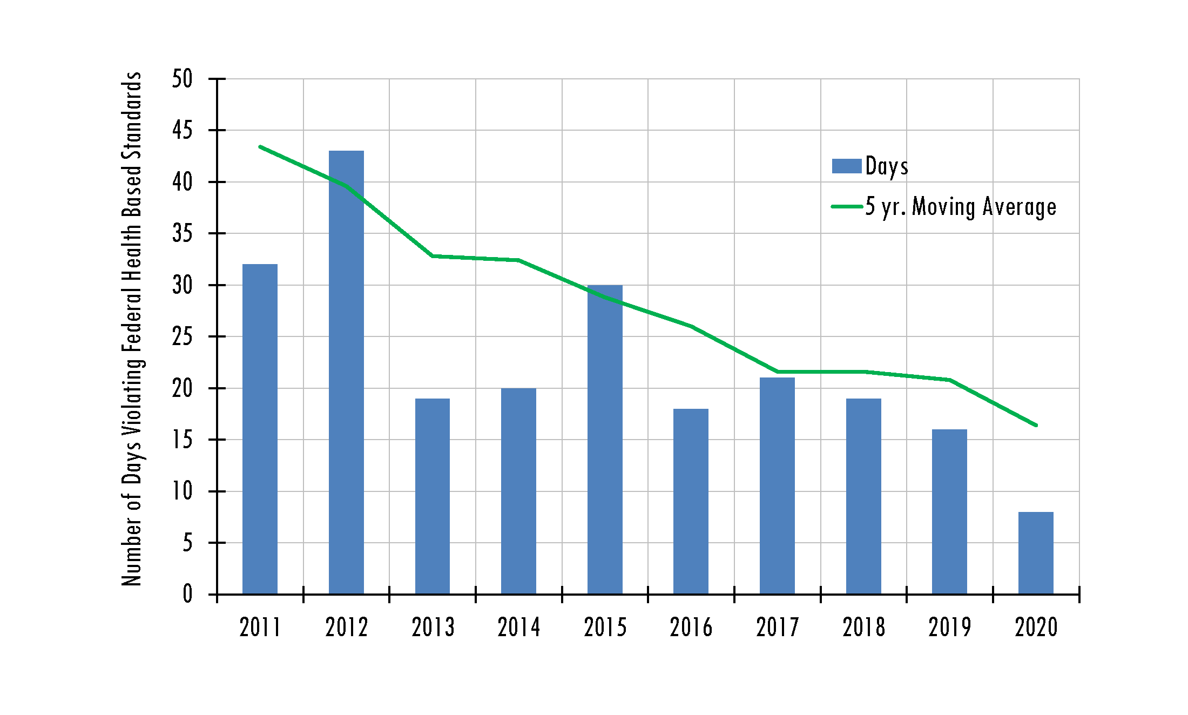
Pollutants and Emissions
Source: 2014 NEI
Source: US EPA

Slide 8
The Challenge
Climate change impacts criteria pollutant formation
Hotter days means more energy use
Science shows the health impacts of pollutants happen at lower exposure = stricter standards
Meeting the standards has permitting and funding implications
Different pollutants but many of the same sources

Slide 9
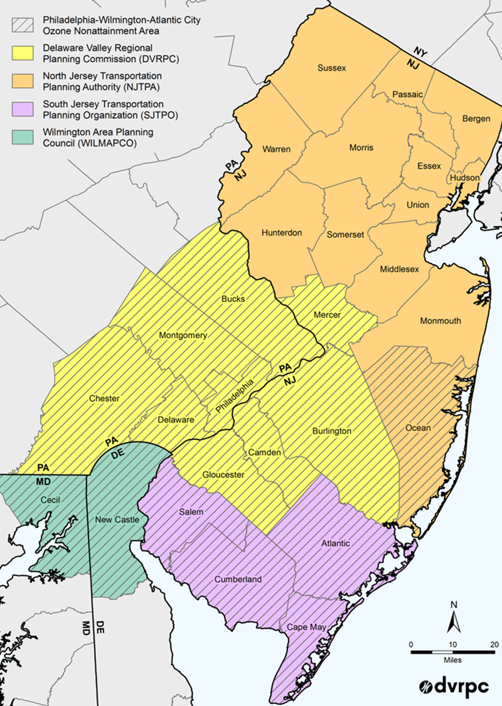
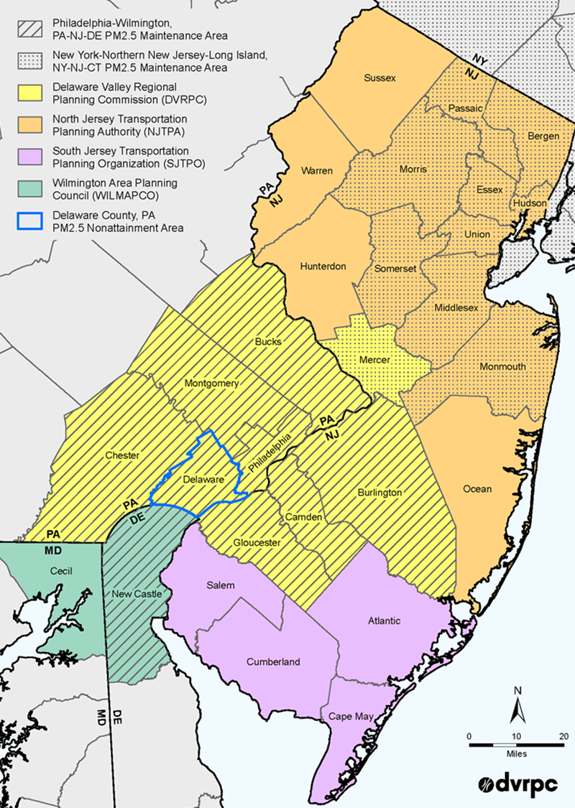
Pollutants and Emissions
Ozone Non-Attainment
PM_{2.5 Maintenance}

Slide 10
What Can We Do?
Transportation, Fossil Fuels, and Energy Use
Use less (Conservation, TDM, Promote better site design and land use strategies)
Use it more efficiently (New technologies, ITS, Allow renewables and clean energy opportunities
Have a plan for this unprecedented investment in infrastructure under the IIJA

Slide 11
Electric Vehicles (Zero Emission Vehicles)
One strategy to reduce GHG and Criteria Pollutants
Light duty ZEVs are here – medium and heavy duty are around the corner
Residents and Governments are buying them (>18,000 EVs in the region)
DVRPC EV Webmap

Slide 12
Residential and At-Work Charging
At home and at work charging are the least expensive and most convenient way to charge
Homes without off-street parking and multi-family units are a challenge
Some level of public infrastructure is required for charging
This is where local government can assist
Public EVSE

Slide 13
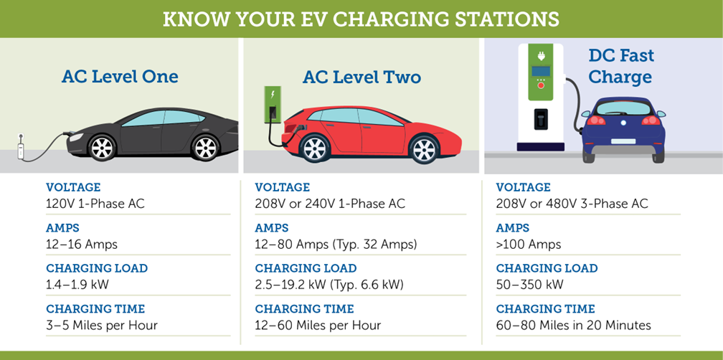
Charging Infrastructure (EVSE)
Costs
Level 2: ~$1,000-$3,000 + Installation
DCFC: ~ $28,000-$140,000 + Installation
Source: International Council on Clean Transportation (2019)
Credit: Advanced Energy (https://www.advancedenergy.org/

Slide 14
Residential and At-Work Charging
Ensure that codes allow for EVSE
Parks, municipal parking lots, public private partnerships
Pricing and dwell time strategies
Homes without off street parking
Pittsburg (ROW EV Charging Rules)
New Jersey (Model Statewide Ordinance)

Slide 15
Municipal Fleets
Environmental and economic benefits
Which vehicles do I replace?
Charging infrastructure (EAP.org)
Funding opportunities
Cooperative purchasing
State Funding
IIJA

Slide 16
Funding Opportunities
COSTARS (PA Cooperative Purchasing)
Alternative Fuel Incentive Program (AFIG)
Driving PA Forward
IIJA (Various Formula and Competitive Programs for EV)
Formula and Competitive Programs
Equity, Resilience, Safety, Economic Growth
White House IIJA Resource Page

Slide 17
Resources
Electric Vehicles in PA
DVRPC Alternative Fuel Vehicle Webpage
Atlas Public Policy Tools
Upcoming Meetings and Presentations
EPA Clean School Bus Briefing May 20 at 10AM - online
DVRPC IIJA Forum for Municipalities May 24 at 11AM - online

Slide 18
Thank You!
Contact:
Sean Greene – Manager, Air Quality Programs
sgreene@dvrpc.org

