Slide 1
PECO IIJA Briefing for DelCo TMA
May 11, 2022
PECO External Affairs

Slide 2
Infrastructure Investment & Jobs Act (IIJA) Funding Categories
The historic Infrastructure Investment and Jobs Act (IIJA) provides new funding opportunities for state, municipal and local entities to drive transformative impact in their communities.
Breakdown of Spending included within the IIJA
IIJA Spending (Billions)
$1,000B
Transportation
$284B
Other Infrastructure
$266B
Reallocation of Base Spending
~$450B*
Roads, Bridges, Major Projects
$110
Passenger and Freight Rail
$66
Power Infrastructure $73
High-Speed Internet Infrastructure
$65
Public Transit
$39
Airports
$25
Water Infrastructure
$55
Resilience
$52
Legislative Process Highlights
President Biden signed the Infrastructure Investment & Jobs Act (IIJA) into law on November 15, 2021
Ports and Waterways
$17
Clean Energy Buses / Ferries
$7.5
Environmental Remediation
$21
Road Safety
$11
Reconnecting Communities
$1
EV Infrastructure
$7.5
*Note: The ~$450B in baseline funds previously authorized by Congress is primarily focused on transportation infrastructure spending (e.g. roads, bridges, and public transit). Note that some of this funding is accessible to states.

Slide 3
Flow of IIJA Funding
About two-thirds of the $1T in IIJA funding will flow through the states to sub-grantees while the remaining one-third will be available through direct applications through the federal agencies.
How will the money be distributed?
~2/3
States will oversee 2/3 of the IIJA money and you will work with them to access the funding
Congress and the White House passed the $1 Trillion IIJA package on November 15th
The $1 Trillion will be allocated to various Federal Agencies
Apply through states
Department of Energy
Department of Transportation
Department of Commerce (NTIA)
Environmental Protection Agency
Department of Homeland Security
Department of Health and Human Services
Other Agencies
The IIJA package consists of $550 Billion in new infrastrucure spending and $450 Billion in reallocation of base spending
Federal Agencies will directly oversee the remainder of IIJA money, and you will apply to them directly
~1/3
Apply through Federal Agencies

Slide 4
Program Requirements Are Currently Under Development / Refinement
Many programs are expected to require recipients to match some portion of the grant funding.
Examples:
Smart Grid Investments Grant has a 50% funding match requirement
Grid Reliability and Resilience Research has a 20% funding match requirement
Power infrastructure R&D has no funding match requirements
Federal agencies are also likely to require regular reporting and data transparency.
Example: National EV program requires an interconnected network to facilitate data collection
Federal agencies are also likely to consider other Biden administration priorities when evaluating applications.
Social equity to support disadvantaged communities
Job creation and workforce preparedness
“Made in America” and domestic manufacturing
Sustainability & resilience to physical and cyber threats (DOE expects submissions to include a comprehensive cyber plan)
Additional program-specific criteria are being developed by the agencies and will be finalized in the coming months.

Slide 5
Opportunities
PECO is exploring IIJA funding opportunities that offer the potential to make our grid cleaner and more resilient while promoting equity and affordability.
We are also working to explore opportunities to partner with our customers and communities on projects that will benefit our region
Operational Opportunities
Partnership Opportunities
Grid Resilience Grants – $5B
Federal/State – 50/50 allocation
EV Corridors - $5B
State Administered Per US DOT
Efficient & Renewable Schools - $500M Competitive Grants
Grid Resilience Demos – $5B
State Administered
AFV Underserved - $2.5B
Federal Competitive Grants
Low-Income Weatherization - $3.5B Grants to States
Smart Grid Investment Grant - $3B, Federal Competitive Grants
Clean School Buses - $5B
Federal Competitive Grants
Additional Opportunities – Transit, Port, Airport, Hydrogen
Energy Storage Demos- $355M, Federal Competitive Grants
PECO is pleased to work with customers pursuing these opportunities by providing letters of support and infrastructure needs analysis

Slide 6
EV Corridors – National Electric Vehicle Infrastructure (NEVI) Program
$5 billion national program (NEVI) to establish a national charging network of high-speed EV chargers along Alternative Fuel Corridors (initially) and other locations
Stations must be located no more than 50 miles apart along AFCs
SE PA’s designated Alternative Fuel Corridors are I-95, I-76, I-476 and US 30
Must have minimum of (4) 150kW chargers capable of operating simultaneously and cannot be on proprietary networks
The program provides 80% federal funding for the establishment of these stations which must be matched by 20% non-federal resources
Pennsylvania receives $171 million under the program, subject to US DOT plan approval
PennDOT is developing its state NEVI plan which must be filed with US DOT by 8/1/22
PennDOT is actively soliciting stakeholder input on the development of its plan, on issues including cost-share options, siting strategies, interoperability, and reliability standards
PennDOT is seeking to submit its plan ahead of the federal deadline to accelerate receipt of federal funds
For Southeast PA, we believe the key issue is how to ensure a funding allocation that matches the region’s high concentration of EV drivers
The five counties of SE PA account for roughly half of all EV drivers in the state

Slide 7
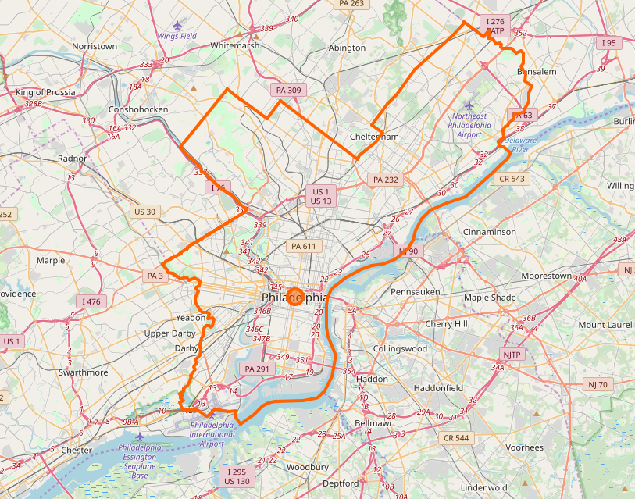
Regional EV Infrastructure Option 1
DESCRIPTION
Establishes large EV stations at 50-mile intervals
Centrally located along Alternative Fuel Corridors
CHALLENGES
Requires large number of EV chargers per site to meet driver demand with high infrastructure cost
May be difficult to site
North-south gaps, low east-west geographic coverage
Limited options to build utilization through combined thru traffic and local usage
Challenge with demand charge mitigation

Slide 8
Regional EV Infrastructure Option 2
DESCRIPTION
Establishes smaller EV stations at more frequent mileage intervals
Distributed along Alternative Fuel Corridors at major highway intersections
BENEFITS
Provide greater options for charging sites that don’t require high-cost capacity upgrades
Greater north-south, and high east-west geographic coverage for drivers
Enhance options to build utilization through combined thru traffic and local usage
Distributes demand charges across system

Slide 9
Clean Transportation Infrastructure for Underserved Communities
$2.5 billion national competitive grant program for Alternative Fuel Vehicle Charging and Fueling, focusing on underserved communities
Competitive grants that local governments, regional planning organizations, community organizations, non-profits and other may apply for
$1.25 billion is prioritized for underserved rural and urban communities, including those with high percentages of households in multi-dwelling unit (MDU) housing
May include a mix of charging levels, with a focus on meeting needs of local communities
Program rules are under development and are expected to be issued in Q4 2022
Pennsylvania does not receive a specific funding allocation under the plan
PennDOT is working with stakeholders to identify opportunities to make PA more competitive for competitive grant opportunities
Locally-developed approaches that bring charging access to a broad range of communities, with a focus on underserved communities are expected to be highly competitive
PECO looks forward to working with our local communities to collaborate on potential applications and support these efforts

Slide 10
Zero-Emission School Bus Program
$5.0 billion national competitive grant program for clean school buses
$2.5 billion within this program allocated to Zero-Emission School Buses
State and local governments, school districts, non-profits and vendors who serve school districts are eligible applicants
Program covers 100% of the incremental cost of ZEV school bus acquisition and customer charging infrastructure upgrades
First year funding is being distributed through rebates under existing US EPA program
Subsequent years may shift to a grant program that is either competitive or lottery-based
PECO is joining the DVRPC and Eastern PA Alliance for Clean Transportation (EP-ACT) to host a Webinar to educate local school districts, county intermediate units and private bus operators on the Clean School Bus program
The Webinar will be held on Friday, May 20 from 10:00 – 11:30 a.m.
The U.S. EPA national office will provide a program overview, along with EPA Region 3
EP-ACT will discuss the application assistance services and existing partnerships that they offer
PECO will describe the process for engaging with the company on potential electrification projects

Slide 11
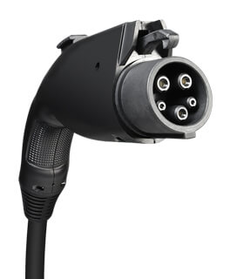
PECO Commercial Level 2 Incentive
Eligibility
Any customer installing new Level 2 EV chargers that will receive electric service from PECO under Rate GS, HT, or PD, including those who choose a competitive electric generation supplier
All C&I use cases are eligible including public, fleet, workplace, customer, and tenant charging
Rebate Amounts
Each Customer, inclusive of affiliates, may receive rebates for a maximum of 20 charging ports
Funds are limited and subject to availability
See the Program Handbook at peco.com/EV for program details
Base Rebate | Lesser of $2,000 per charging port or 50% of make-ready costs
Enhanced Rebate for projects located in Environmental Justice Areas | Lesser of $3,000 per charging port or 75% of make-ready costs

