Slide 1
Electric Vehicle Infrastructure and Air Quality Initiatives
May 11, 2022
DCTMA Municipalities Conference

Slide 2
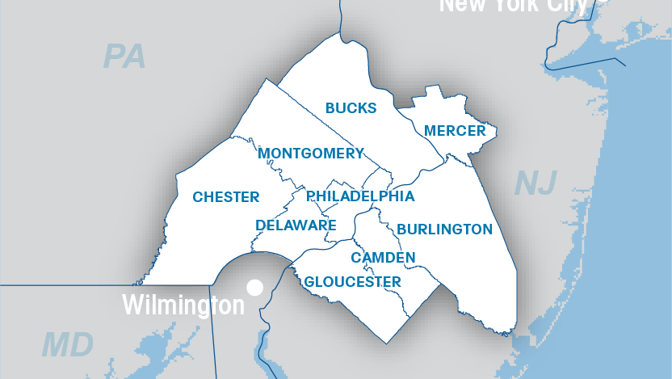
Notes:
MPO’s are federally mandated transportation policy-making organization required for areas with more than 50,000 people in order to access federal funding for transportation projects.
MPO’s core functions:
Provide an impartial setting for regional decision-making.
Evaluate transportation alternatives.
Develop/maintain a long-range transportation plan (LRP).
Develop a transportation improvement program (TIP).
Involve the public in regional decision-making and the development of the LRP and the TIP.
Protect air quality.
DVRPC is the MPO for Greater Philadelphia.
DVRPC Region (the Delaware Valley or Greater Philadelphia)
2 states: Pennsylvania and New Jersey 9 counties: Bucks, Chester, Delaware, Montgomery, and Philadelphia counties in Pennsylvania; and Burlington, Camden, Gloucester, and Mercer in New Jersey
353 municipalities
Nearly 2.5 million acres of land
The People
5.5 million population
2.8 million jobs
By 2035:
6.1 million population
3.1 million jobs
Federally-designated MPO
for nine-county region in
PA and NJ
Created in 1965 to plan for
“orderly growth and
development”
Transportation, land use,
open space, housing and
economic development
Short, medium and long
term transportation plans
provide funding for projects

Slide 3
Overview
Emissions – Climate Change and Health
Delaware County Air Quality
Strategies for Improvement – Electric Vehicles
Funding
Resources

Slide 4
Pollutants and Emissions
Climate Change – Greenhouse Gases (GHG)
  Region is getting warmer and wetter – more days over 90º
  Frequency and power of extreme weather events – more precipitation delivered in big storms
  Sea-level rise impacts communities on the Delaware River and beyond
  Sources of GHGs – Commercial and residential energy use, and transportation

Slide 5
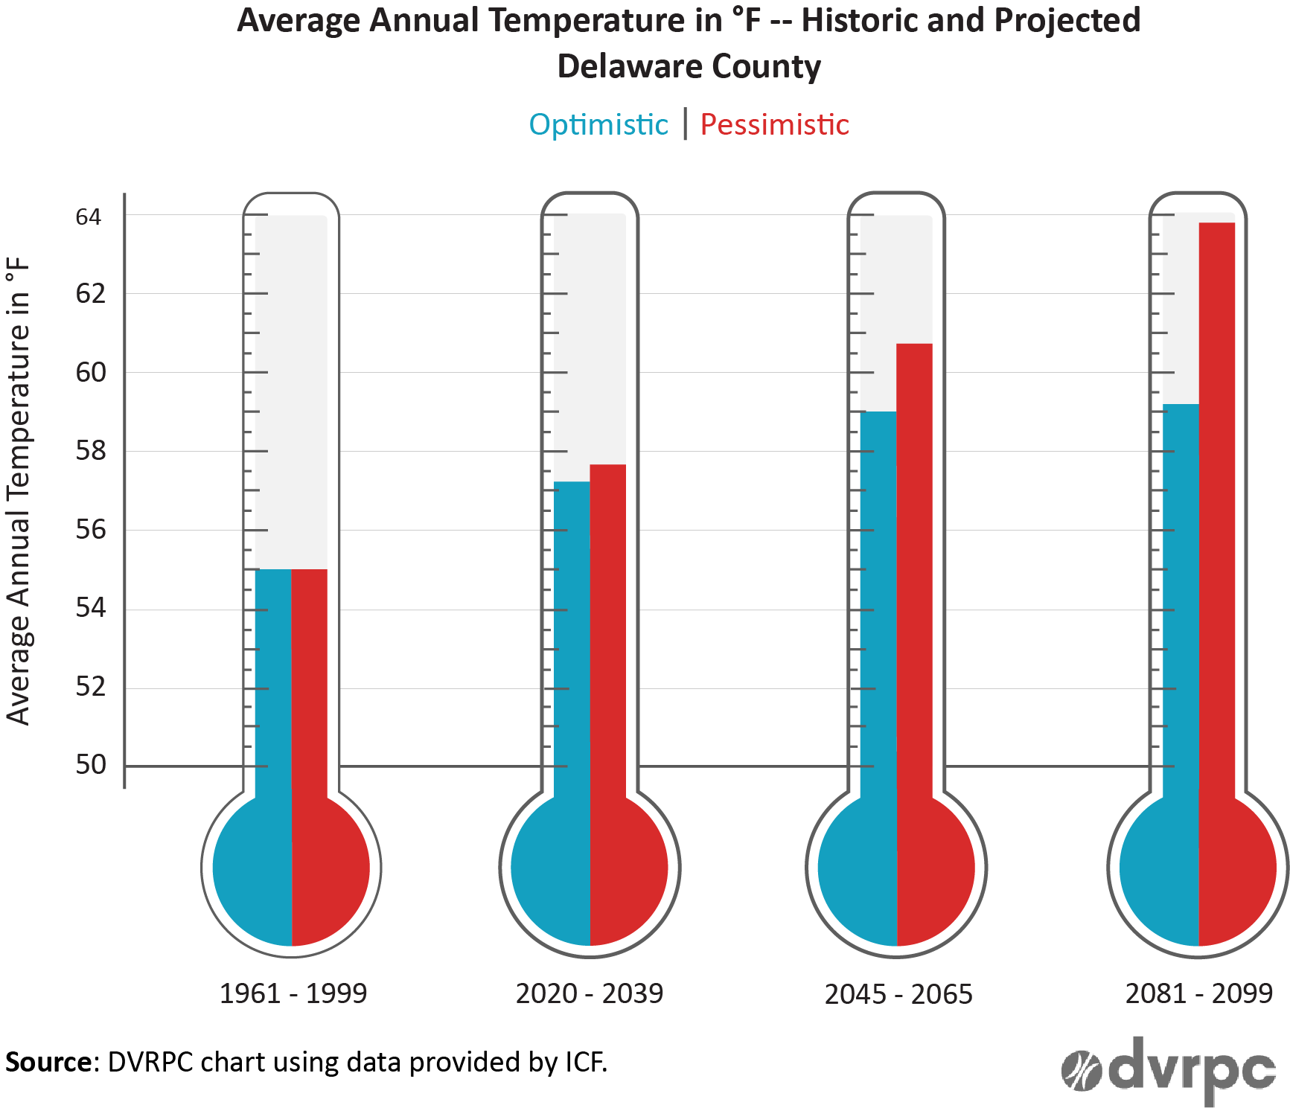
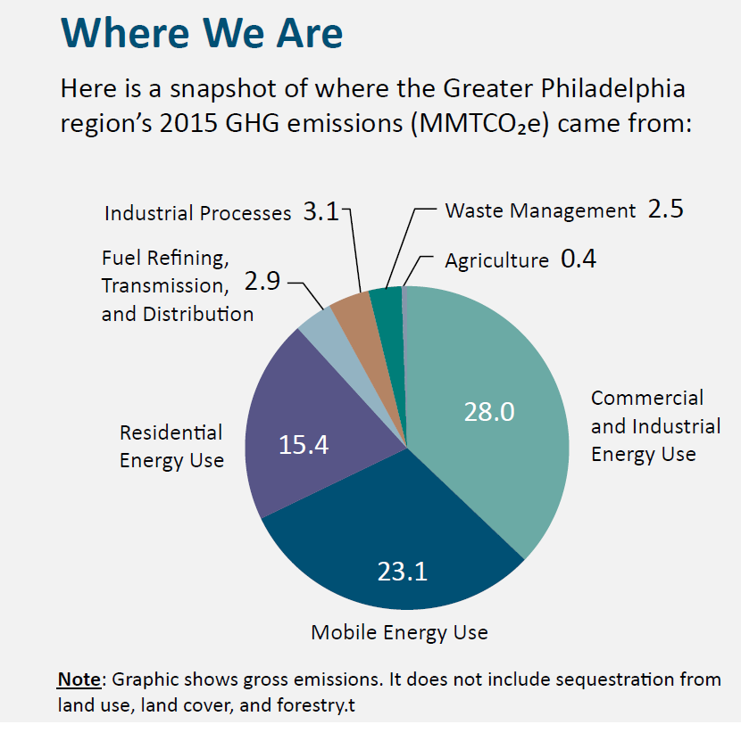
Pollutants and Emissions
Source: DVRPC 2015 GHG Inventory

Slide 6
Pollutants and Emissions
Criteria Pollutants – Ozone and PM_{2.5}
  Impact cardio-vascular health
  Lung damage, heart damage, early death, more susceptible to infection
  Sources of criteria pollutants – energy generation, industry, and transportation
  On-road mobile sources – cars, trucks, buses
    Accounts for 38% NO_{x}, 14% VOC, 3% PM_{2.5}
Combine to form Ozone
          Source: FHWA Transportation Air Quality Selected Facts and Figures

Slide 7
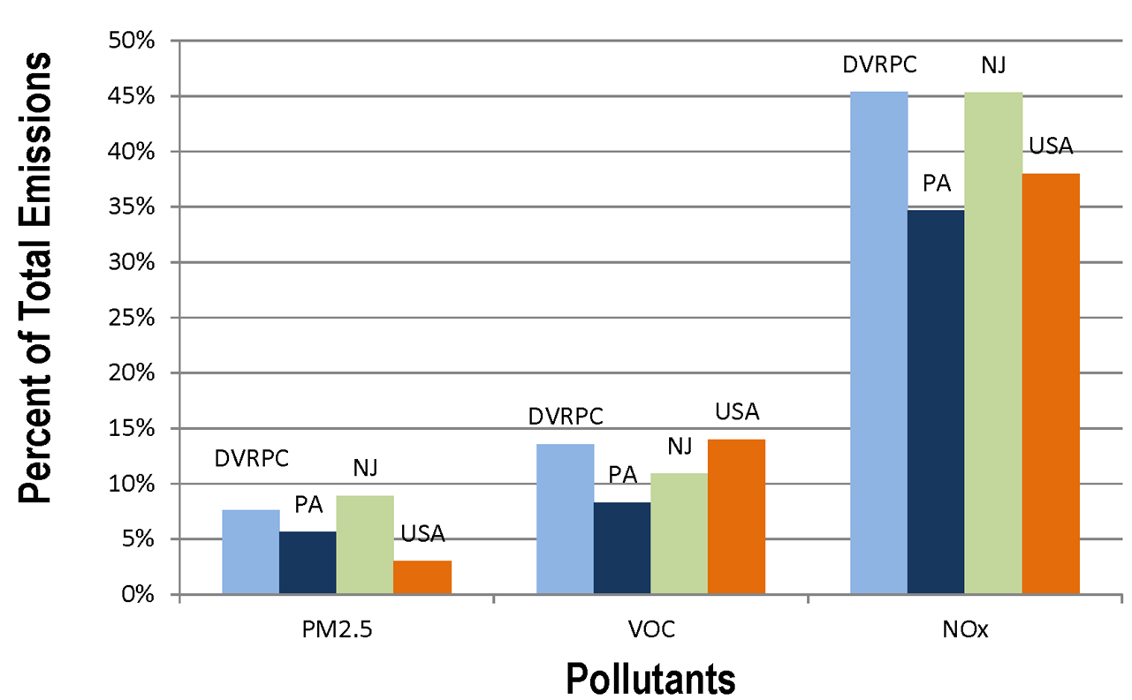
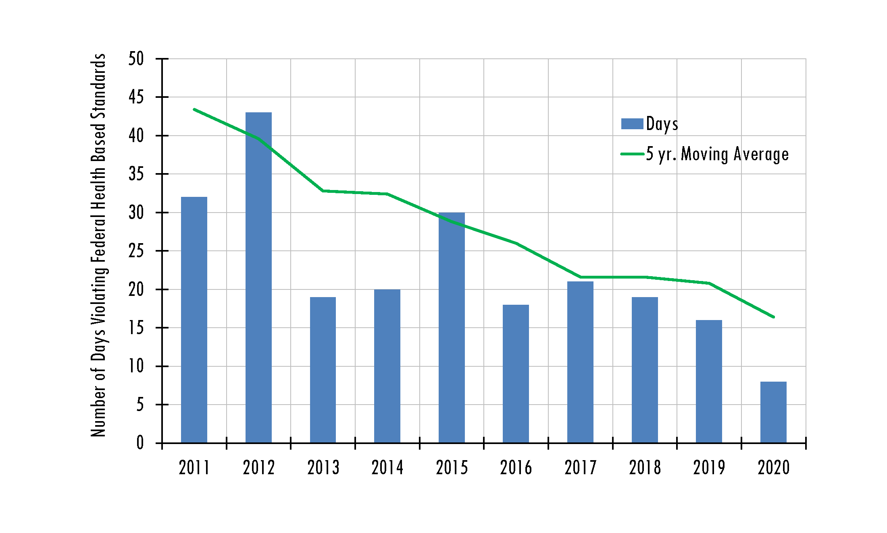
Pollutants and Emissions
Source: 2014 NEI
Source: US EPA

Slide 8
The Challenge
Climate change impacts criteria pollutant formation
Hotter days means more energy use
Science shows the health impacts of pollutants happen at lower exposure = stricter standards
Meeting the standards has permitting and funding implications
Different pollutants but many of the same sources

Slide 9
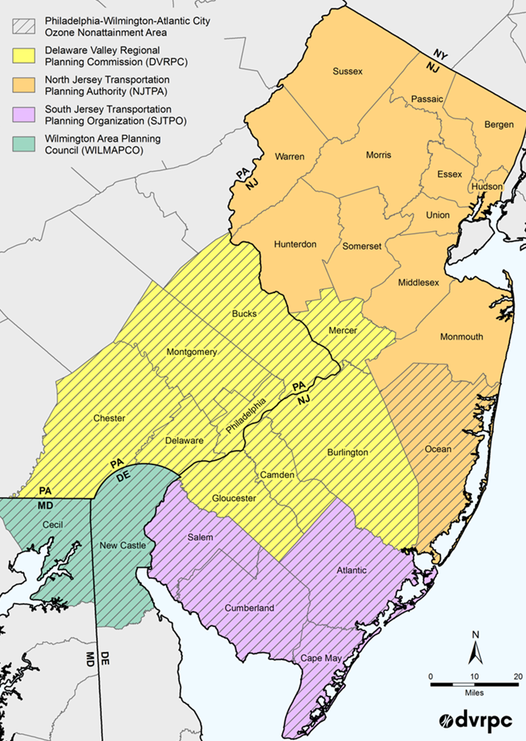
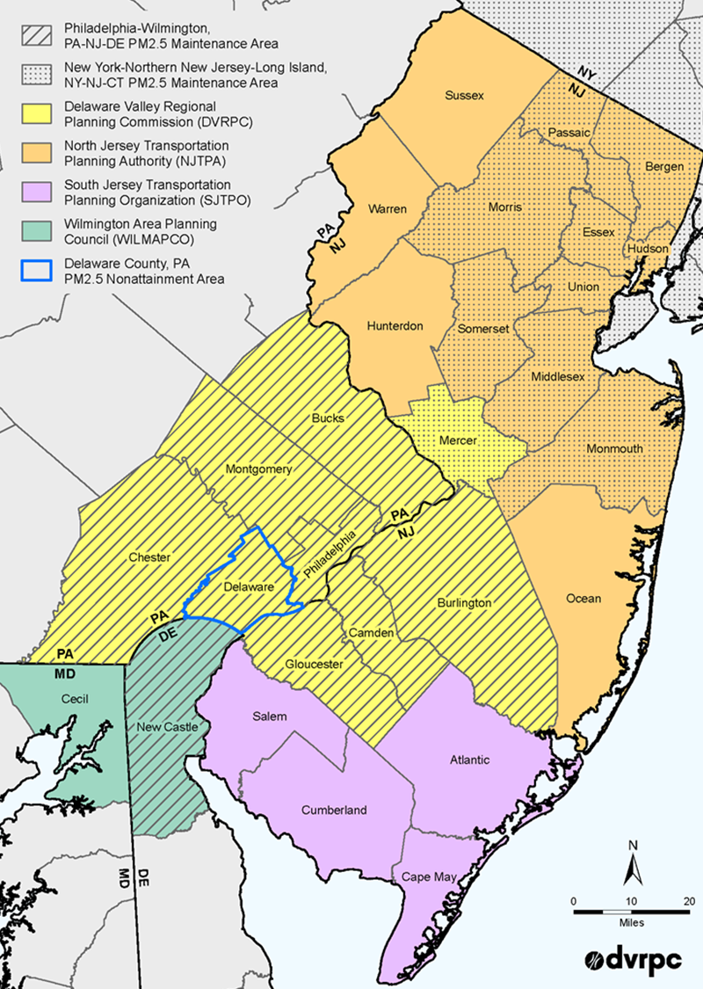
Pollutants and Emissions
Ozone
Non-Attainment
PM_{2.5 Maintenance}

Slide 10
What Can We Do?
Transportation, Fossil Fuels, and Energy Use
  Use less (Conservation, TDM, Promote better site design and land use strategies)
  Use it more efficiently (New technologies, ITS, Allow renewables and clean energy opportunities
  Have a plan for this unprecedented investment in infrastructure under the IIJA

Slide 11
Electric Vehicles (Zero Emission Vehicles)
One strategy to reduce GHG and Criteria Pollutants
Light duty ZEVs are here – medium and heavy duty are around the corner
Residents and Governments are buying them (>18,000 EVs in the region)
DVRPC EV Webmap

Slide 12
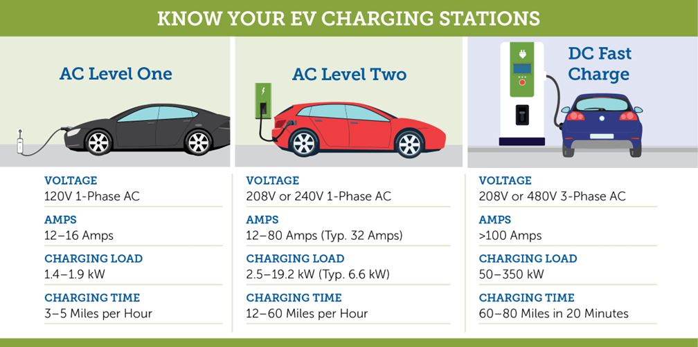
Charging Infrastructure (EVSE)
Costs
Level 2: ~$1,000-$3,000 + Installation
DCFC: ~ $28,000-$140,000 + Installation
Source: International Council on Clean Transportation (2019)
Credit: Advanced Energy (https://www.advancedenergy.org/)

Slide 13
Residential and At-Work Charging
At home and at work charging are the least expensive and most convenient way to charge
Homes without off-street parking and multi-family units are a challenge
Some level of public infrastructure is required for charging
  This is where local government can assist
Public EVSE

Slide 14
Residential and At-Work Charging
Ensure that codes allow for EVSE
Parks, municipal parking lots, public private partnerships
  Pricing and dwell time strategies
Homes without off street parking
  Pittsburgh (ROW EV Charging Rules)
  New Jersey (Model Statewide Ordinance)

Slide 15
Municipal Fleets
Environmental and economic benefits
Which vehicles do I replace?
Charging infrastructure (EAP.org)
Funding opportunities
  Cooperative purchasing
  State Funding
  IIJA

Slide 16
Funding Opportunities
COSTARS (PA Cooperative Purchasing)
Alternative Fuel Incentive Program (AFIG)
Driving PA Forward
IIJA (Various Formula and Competitive Programs for EV)
  Formula and Competitive Programs
  Equity, Resilience, Safety, Economic Growth
White House IIJA Resource Page

Slide 17
Resources
Electric Vehicles in PA
DVRPC Alternative Fuel Vehicle Webpage
Atlas Public Policy Tools
Upcoming Meetings and Presentations
  EPA Clean School Bus Briefing May 20 at 10AM - online
  DVRPC IIJA Forum for Municipalities May 24 at 11AM - online

Slide 18
Thank You!
Contact:
Sean Greene – Manager, Air Quality Programs
sgreene@dvrpc.org

Slide 19
Truck Network Designation
Notes:
Given the unprecedented investment in infrastructure, planners at the regional, county and municipal level can take advantage of these opportunities to create plans and implement changes that address freight and truck patterns and behavior.
Designating a truck network is a key step in planning for freight movement.

Slide 20
Truck network designation can better position communities to implement freight demand strategies that have the potential to reduce congestion and operational impacts of trucks on their communities.
Notes:
At DVRPC our freight office has created a framework for designating a truck network that can be used by any municipality

Slide 21

Where do we start?
Transit network
Bike network
Base network
Notes:
Region wide we are having more robust planning conversations about the interaction between different modes and how we can balance the demands of individual networks components to reduce conflict
Can’t be intentional with design and network users if we don’t differentiate truck from other auto
Truck network sig step in planning for design components
If we don’t acknowledge where they are, how can we know what facilities are compatible

Slide 22
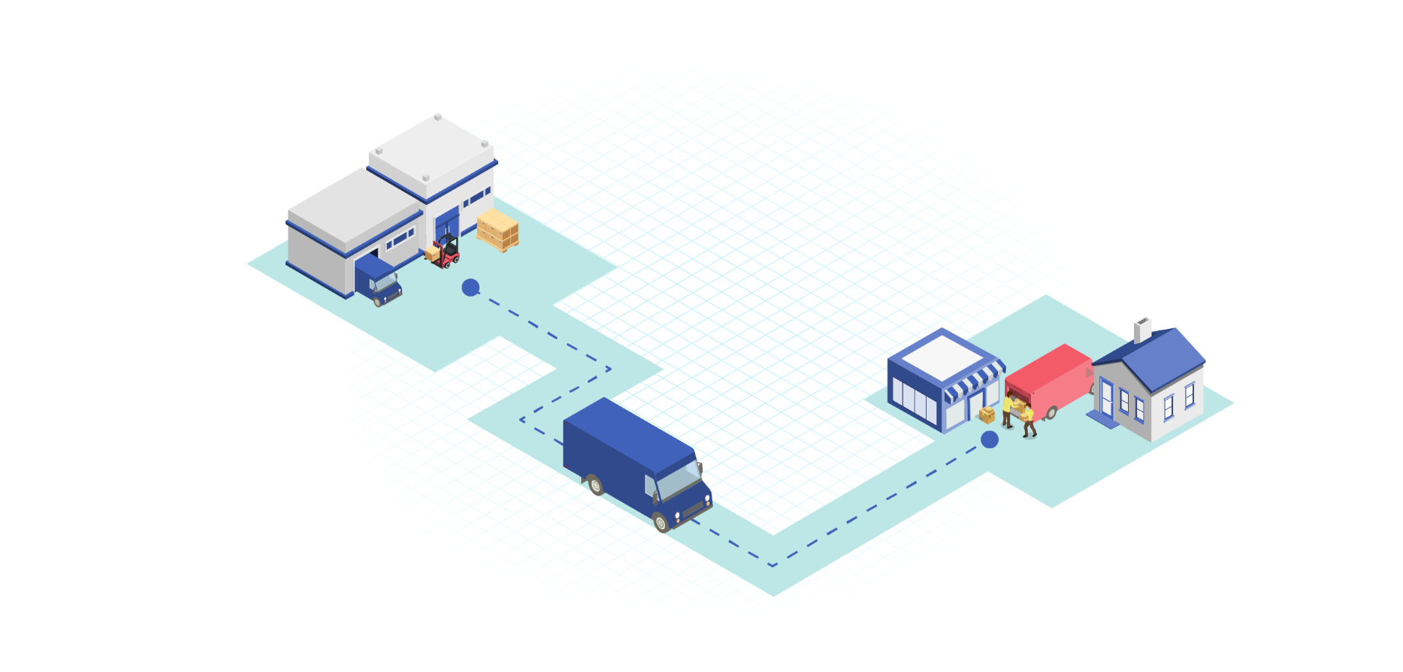

Defining a Truck Network
Preliminary Screening
Understand key generators and connectivity.
Preliminary network matched to existing classification system.
Data Evaluation
Quantify route segment activity.
Confirm route segment role/use.
Review & Adoption
Educate the public and promote buy-in on route designation.
Formally adopt the truck route components.
Application
Communicate new route designation to key stakeholders.
Incorporate improvements/considerations for truck freight.
Notes:
We’ve outlined a four-step (highly iterative) process for defining a truck route

Slide 23
Truck Network Components
Truck Route Class | Freight Class Function
Regional Freight Corridors | Long Distance Trips
Primary Truck Route | Through Trips
Secondary Truck Route | To/From Trips
Last Mile Connector | Industrial Trips
+ Restricted Facilities
Notes:
We have identified four truck route classifications, each with a different trip function- ranked here roughly from longest trip to shortest trip
And a fifth, critical component of the network designation are restricted facilities- facilities where trucks should not be.
You may look at this list and think- that’s a lot of truck routes. But the distictions in their use are important for planning purposes, and don’t need to be, and shouldn’t, all signed on our roads.

Slide 24
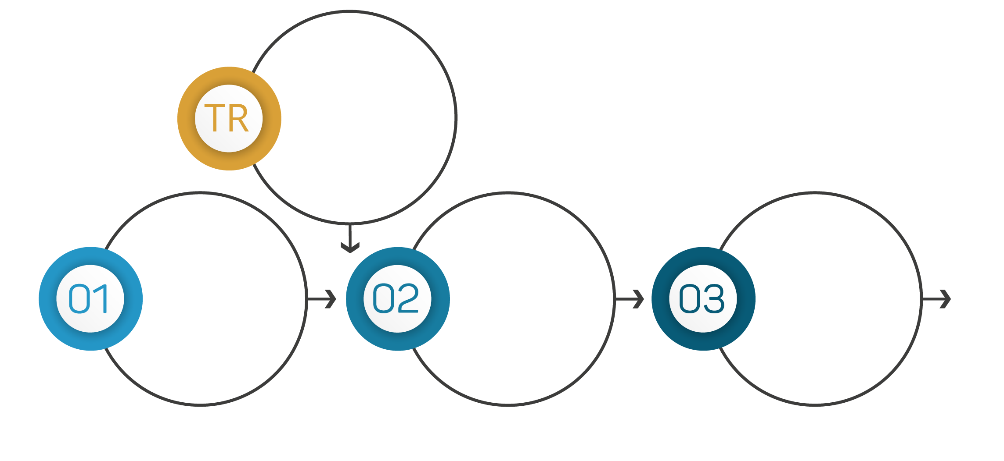
Leveraging Existing Processes
Truck Route
Typology
Identify Appropriate Design Treatments
Design & Locate Individual Street Treatments
Determine Street Type

Slide 25
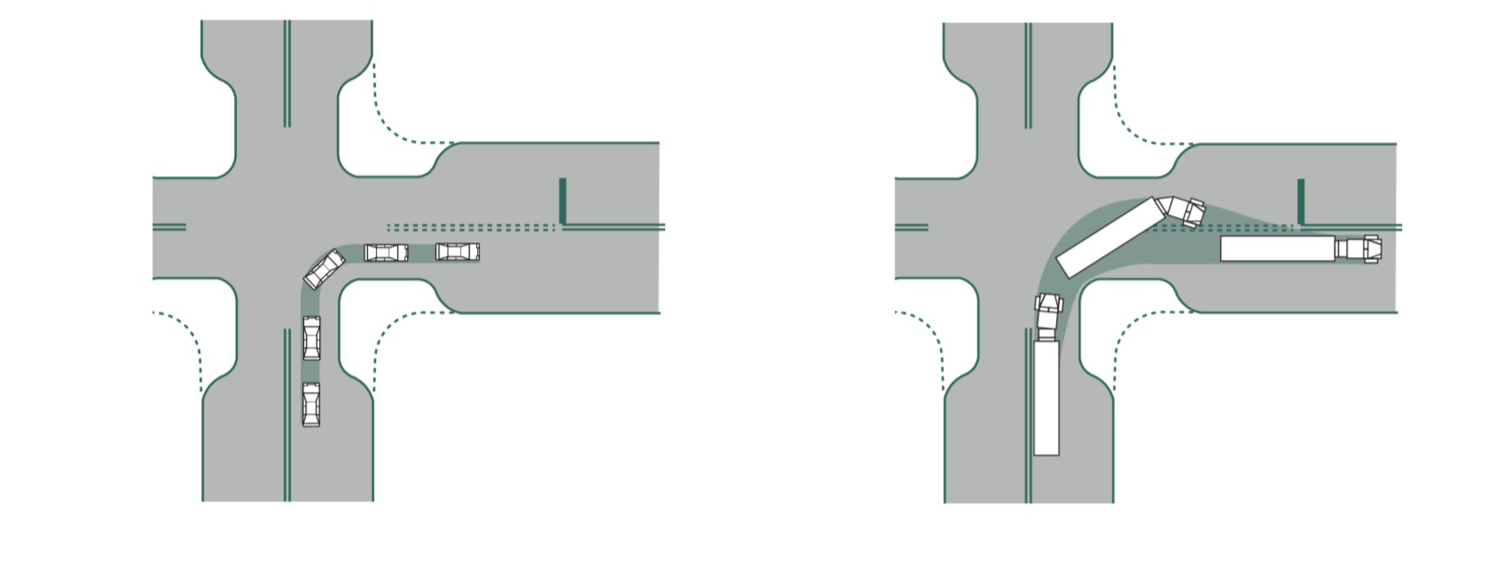
Design and Control Vehicles
Design Vehicle | Control Vehicle
frequent user of a given street | infrequent, larger user of a given street
dictates the minimum required turning radius | road accommodates these vehicles
can turn using one incoming and one receiving lane | can turn using multiple lane spaces
Source: NACTO Urban Street Design Guidelines

Slide 26
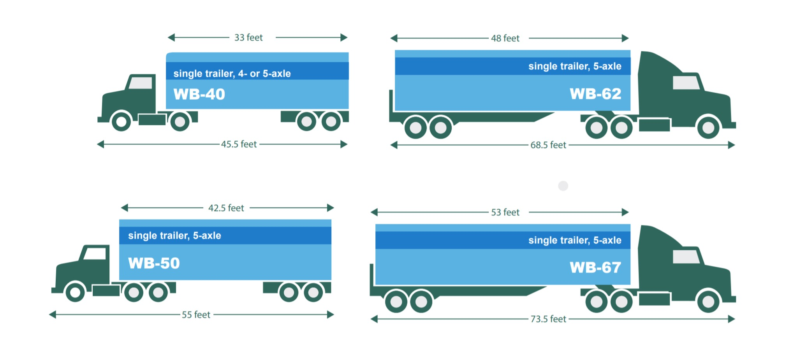
Design and Control Vehicles

Slide 27
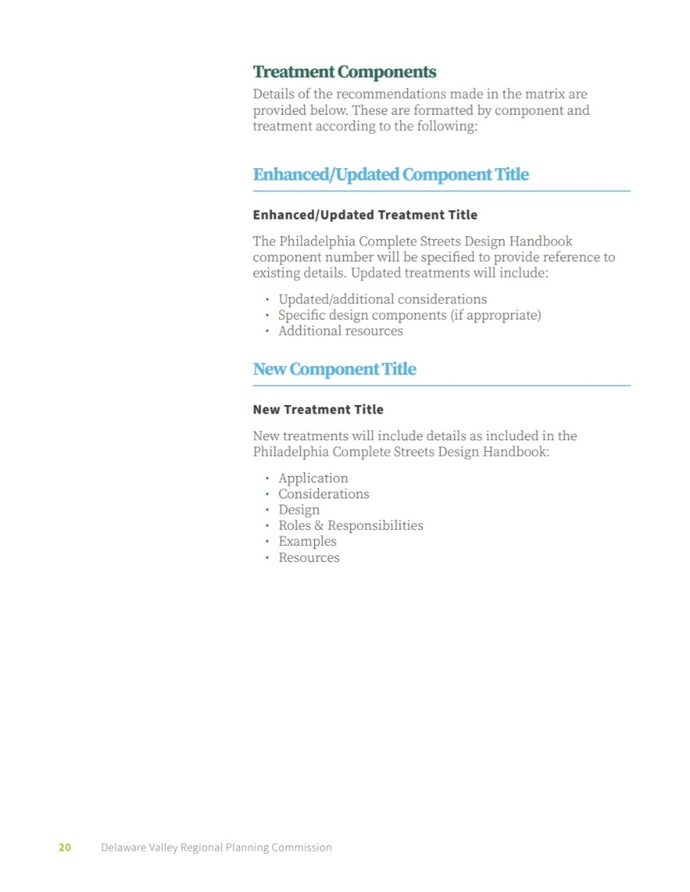
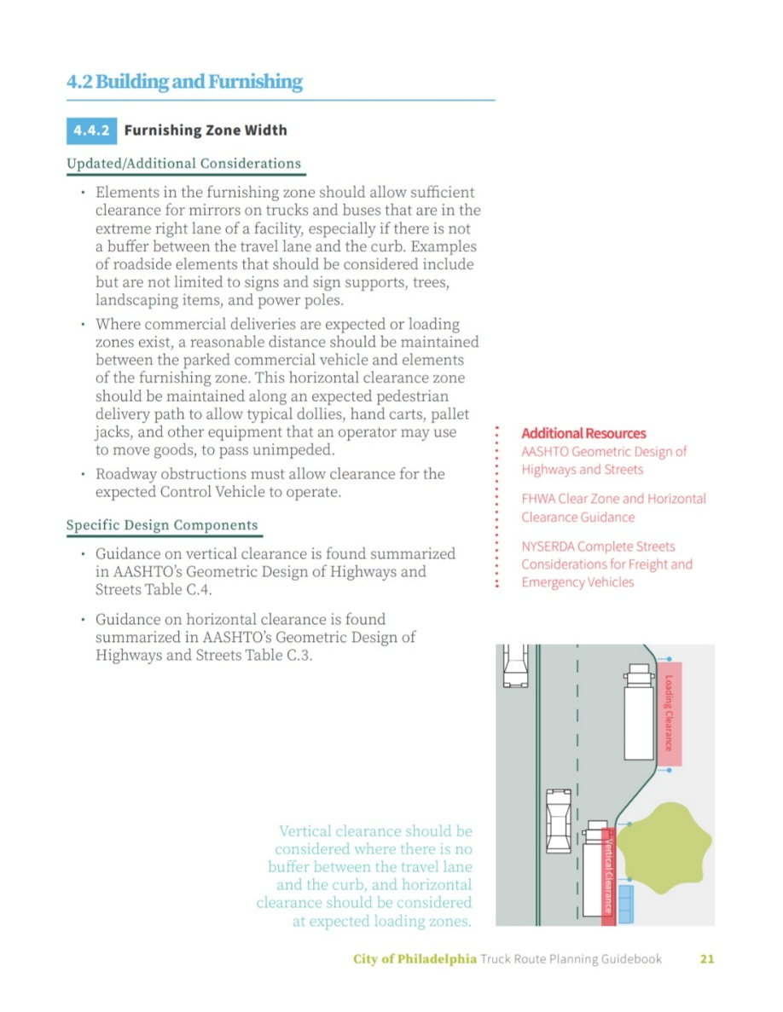
Design Recommendations

Slide 28
Wayfinding and Signage

Slide 29
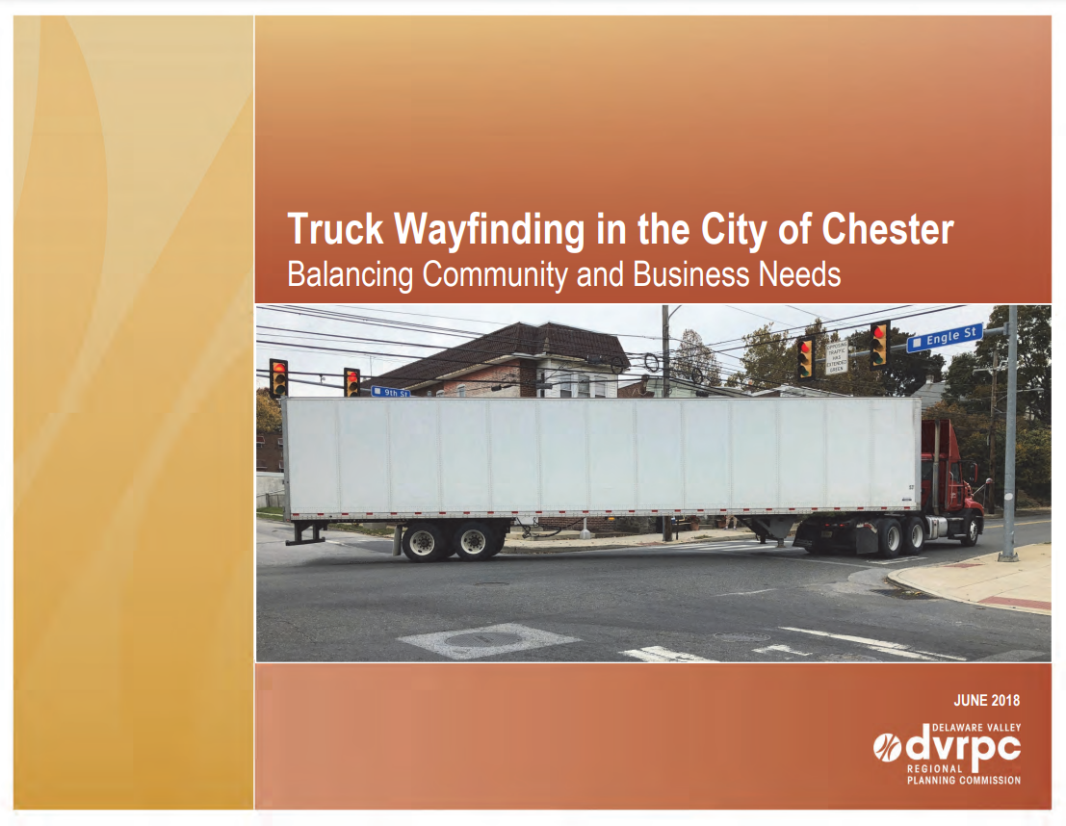
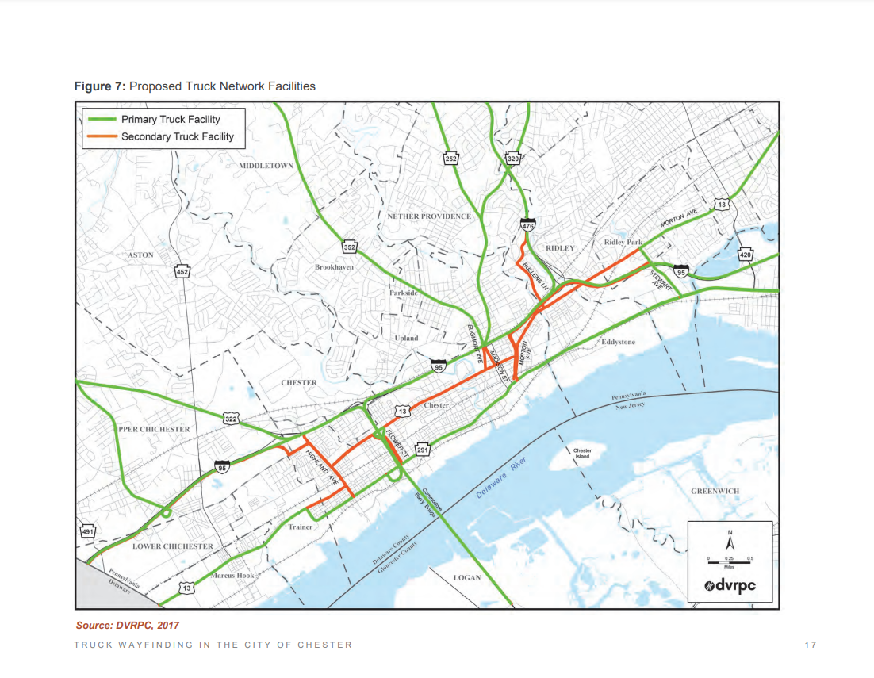
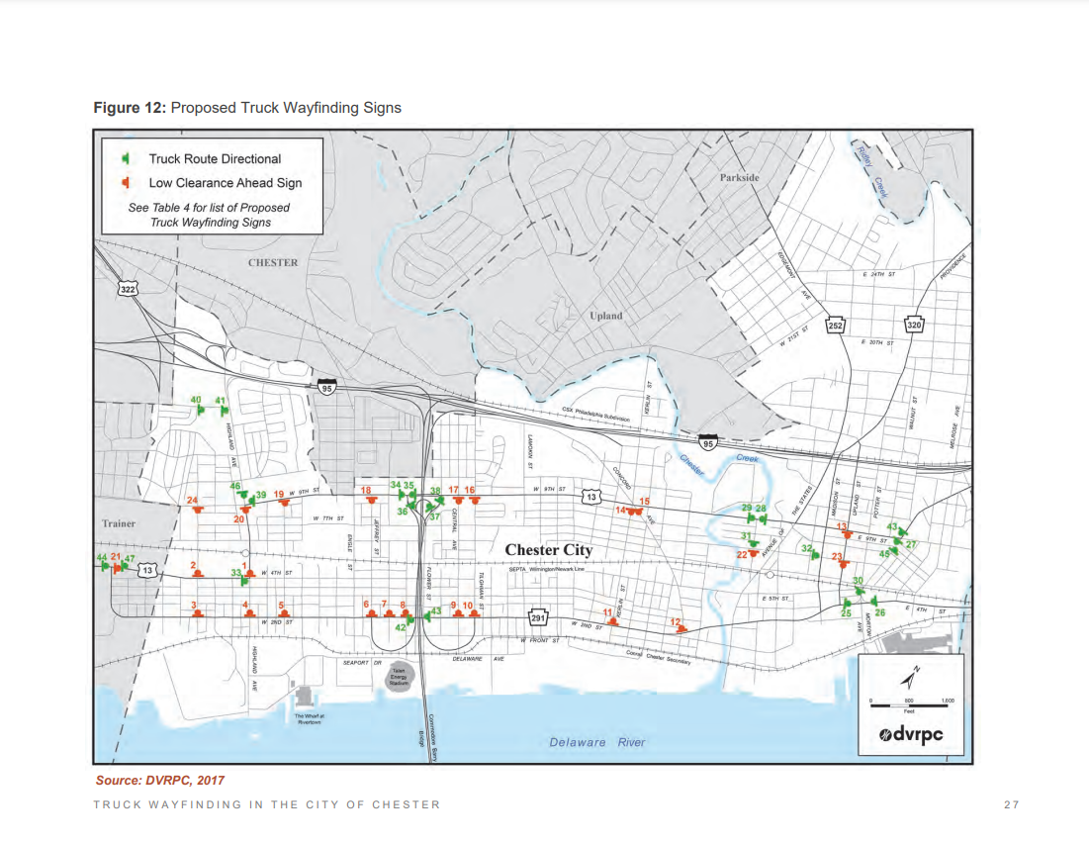
Framework Implementation in Chester

Slide 30
Study Recommendations
Proposed US-13 Business Route
Proposed Waterfront Truck Access Routes
Alternative Access Routes
Central Business District Access Routes
Wayfinding Signage
Street Design Improvements

Slide 31
Funding Opportunities
Planning
Transportation and Community Development Initiative (TCDI) www.dvrpc.org/tcdi/
DCED Municipal Assistance Program (MAP) www.dced.pa.gov/programs/municipal-assistance-program-map/
Implementation
PennDOT Multimodal Transportation Fund (MTF) www.penndot.pa.gov/ProjectAndPrograms/MultimodalProgram
Congestion Mitigation and Air Quality (CMAQ) https://www.epa.gov/cmaq

Slide 32
IIJA Funding Available to a Range of Recipients
Program Examples | State | MPO | Local | Tribe | PA* | Territory | FLMA*
Apportioned programs (formula) | ✓
Bridge Program (formula) | ✓ |  |  | ✓
National Electric Vehicle Formula Program | ✓ |  | ✓
Safe Streets and Roads for All program |  | ✓ | ✓ | ✓
PROTECT Grants (discretionary) | ✓ | ✓ | ✓ | ✓ | ✓ |  | ✓
Charging and Fueling Infrastructure Program | ✓ | ✓ | ✓ | ✓ | ✓ | ✓
Congestion Relief Program | ✓ | ✓ | ✓
Bridge Investment Program (discretionary) | ✓ | ✓ | ✓ | ✓ | ✓ |  | ✓
Reconnecting Communities Pilot Program | ✓ | ✓ | ✓ | ✓
Rural Surface Transportation Grants | ✓ |  | ✓ | ✓
INFRA | ✓ | ✓ | ✓ | ✓ | ✓ |  | ✓
Nat’l Infra. Project Assistance | ✓ | ✓ | ✓ | ✓ | ✓
Local and Regional Project Assistance | ✓ | ✓ | ✓ | ✓ | ✓ | ✓
Note: This table does not include all BIL programs or eligible entities, and there are additional nuances not represented in this table. Additional programmatic information is provided in later slides. FHWA will administer most, but not all, programs listed.
* ”PA” means a special purpose district or public authority with a transportation function; FLMA means Federal Land Management Agency
Notes:
Railroad Crossing Elimination [new] - $3 billion
To promote highway rail or pathway-rail grade crossing improvement projects that focus on improving the safety and mobility of people and goods
Promoting Resilient Operations for Transformative, Efficient, and Cost-saving Transportation (PROTECT) [new] - $1.4 billion
enhancing the resiliency of infrastructure assets, including projects to improve the resilience of surface transportation assets and evacuation routes
Planning Grants at $140 million
Resilience Improvement Grants at $980 million

Slide 33
Thank You!
Kristen Scudder
Freight Program Manager
kscudder@dvrpc.org

