Slide 1
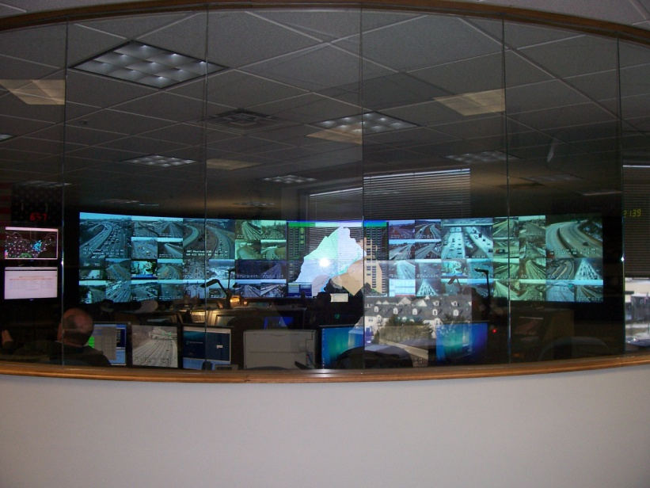
Eastern RTMC

Slide 2
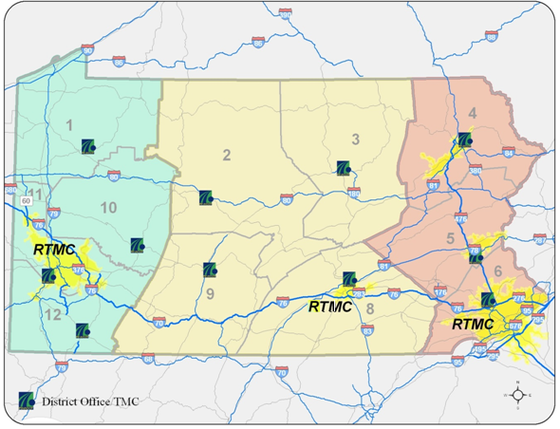
Regional Traffic Management Centers
Notes:
Regional Traffic Management Centers are the nucleus of the PA 511 System regarding roadway closures
32 counties

Slide 3
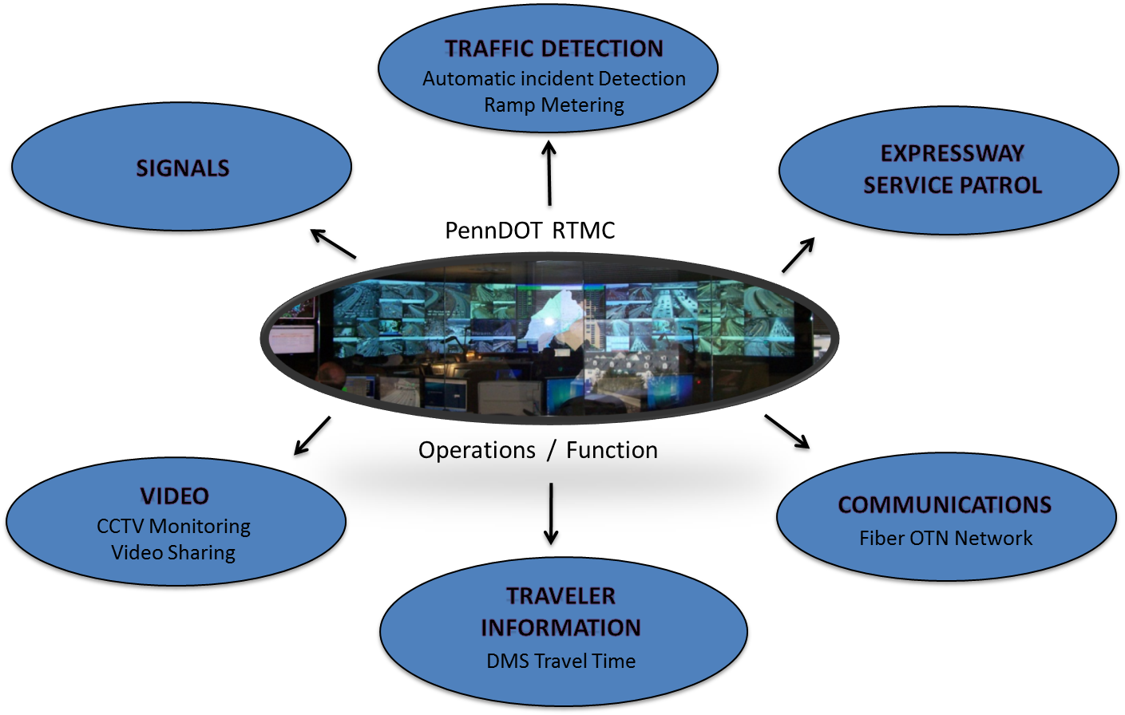
2013 RTMC Operations Overview

Slide 4
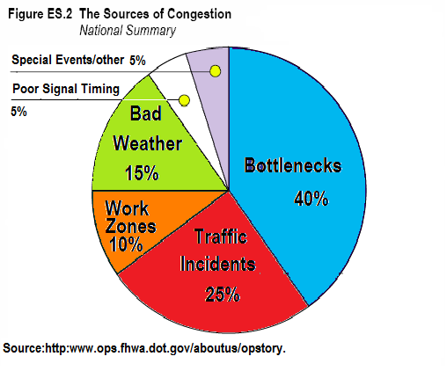
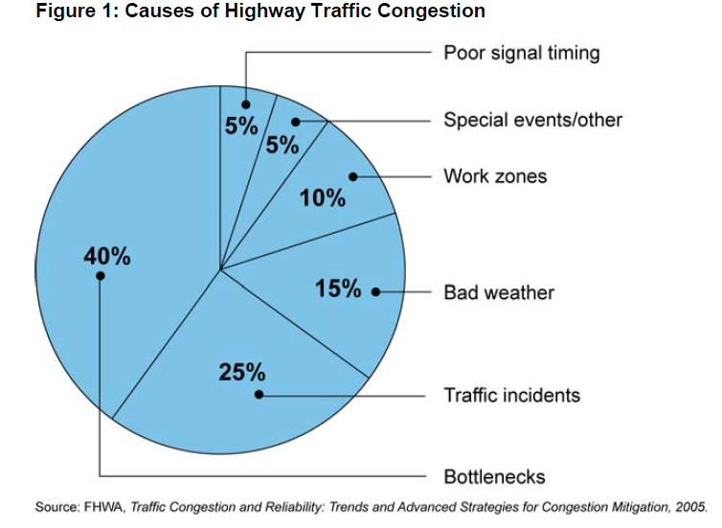
What is the problem?

Slide 5

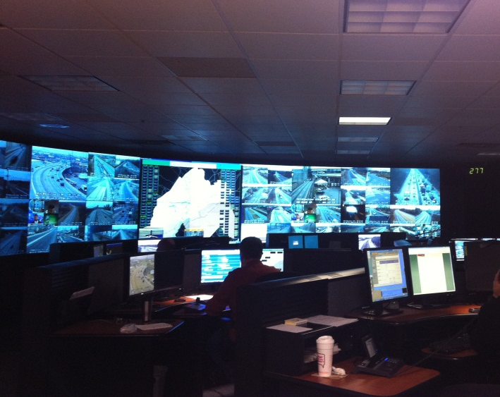
TIMS Program Timeline
1993 – TMC opens in St. Davids, PA and manages a network of 12 CCTV and 4 DMS
1997 – TIMS Expanded to include Ramp Metering
2000 – TMC Moved to current location in King of Prussia, added Expressway Service Patrols, TIMS Expanded to include the beginnings of the ATMS software with Automated Incident Detection module. Began Video Sharing with stakeholders
2007- TIMS Expanded to include Travel Times, Fiber Network Communications
2010 – TIMS Expanded to include Origin-Destination based travel times (E-ZPass Protocol)
2011 – PA 23 becomes first integrated arterial ITS corridor. Followed by city arterials parallel to I-95, Route 63 corridor, Route 1 and the 202 Parkway corridor
2013 – TIMS to operate Bluetooth based Travel Time System. Reconfigured communication network providing true diversity and redundancy. Active monitoring of signal systems

Slide 6
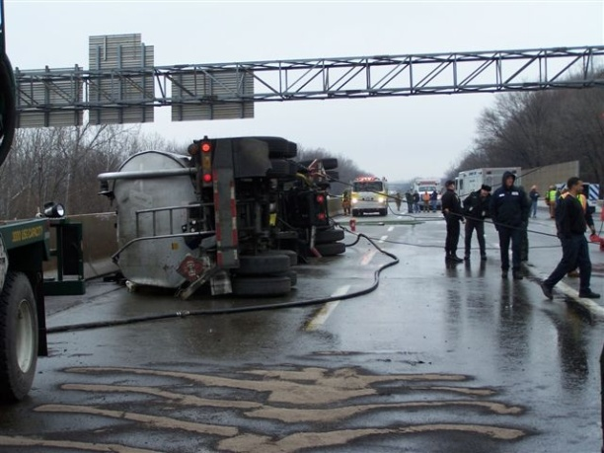
RTMC Mission: Challenges and Opportunities
Reduce Congestion
Inform Motorists & Post Travel Times
Incident Management:
  Service Patrols
  Quick Clearance
  Ensure Responder Safety
  IM Task Forces by Corridor
  Coordinate/Share resources.
Communicate!
Active Traffic Management
  .Reduce Primary Crashes
  Reduce Secondary Crashes
  Reduce Crash Severities
New!

Slide 7
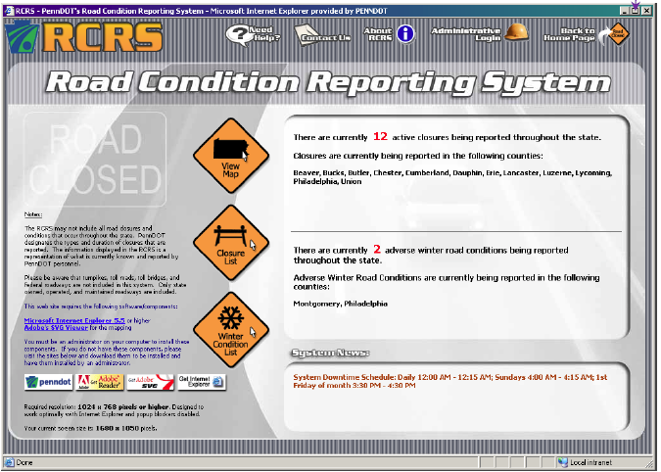

Slide 8
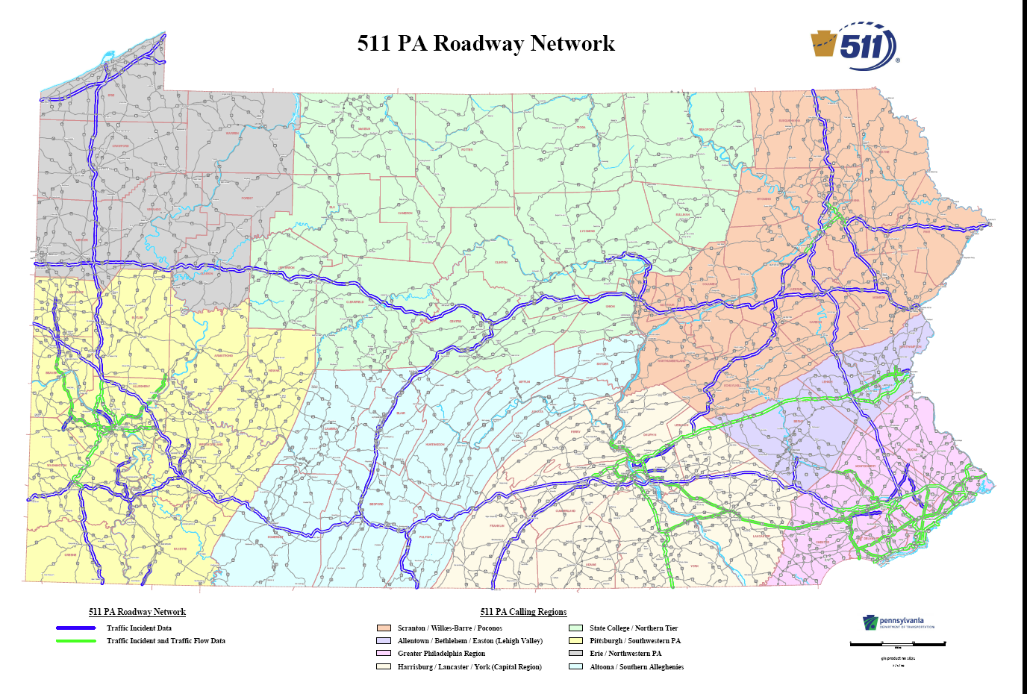
http://www.511pa.com

Slide 9
REGIONAL COMMUNICATIONS
RIMIS
Regional Integrated Multimodal Information Sharing

Slide 10

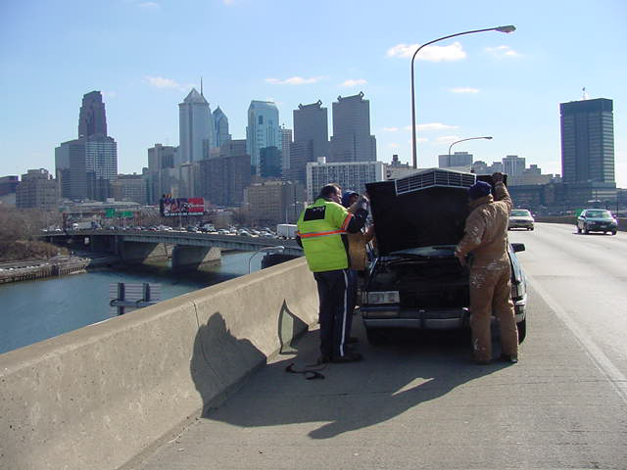
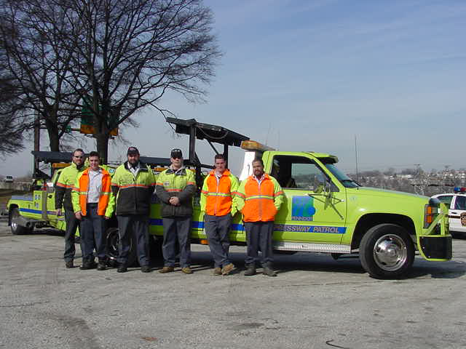
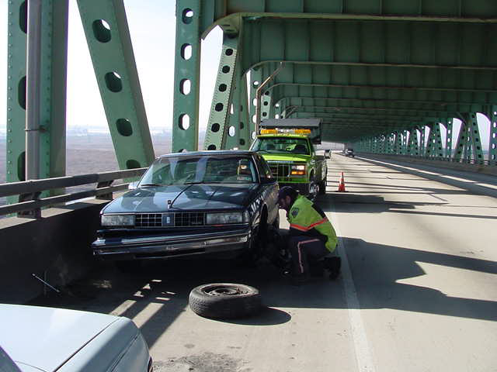
Expressway Service Patrol

Slide 11
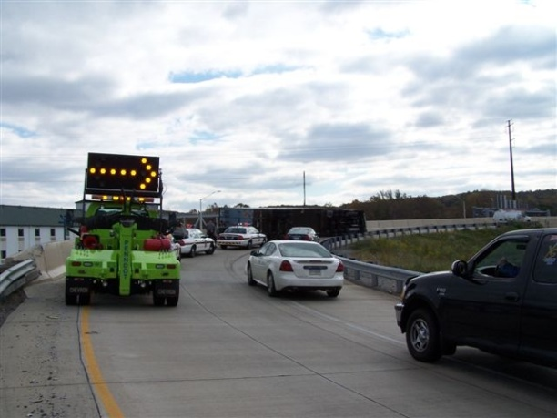
Expressway Service Patrol
Dispatched Service of 10 Service Patrol Vehicles Provide to Motorists:
- Assist or tow stranded motorists.
- Provide traffic control during incidents.
Remove debris.
11,513 Assists in 2012

Slide 13
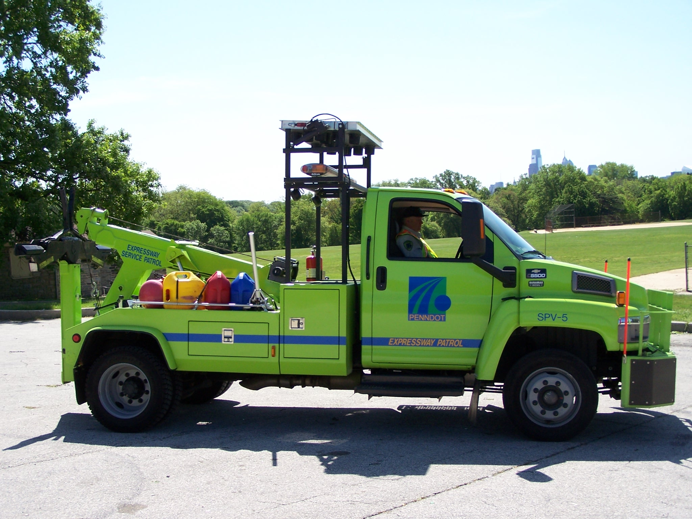

Slide 14
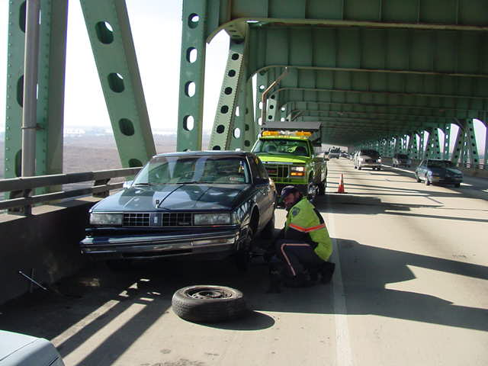

Slide 15
ITS Deployments at a Glance
325 CCTV Cameras
110 Permanent, 15 Semi-Permanent DMS
360 Vehicle Detection Stations
150 Travel Time detection stations
15 Ramp Metering Locations
31 Communications Hubs
465 Miles of Fiber Optic Cable
450 integrated traffic signals

Slide 18
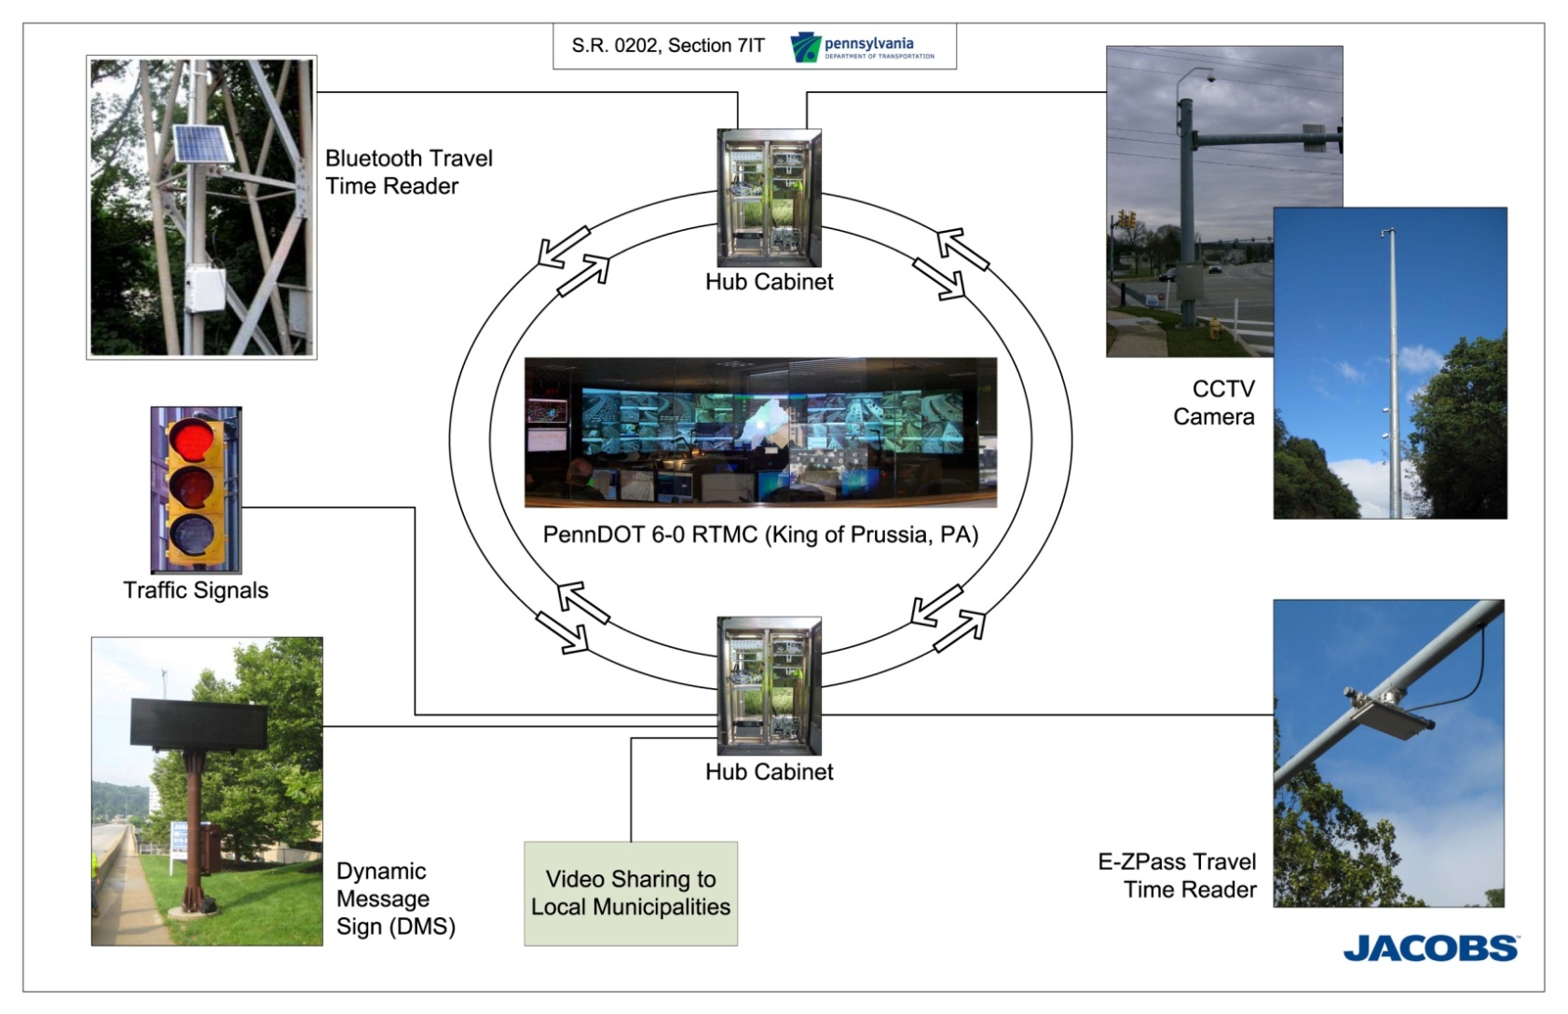
Device to RTMC Overview

Slide 19
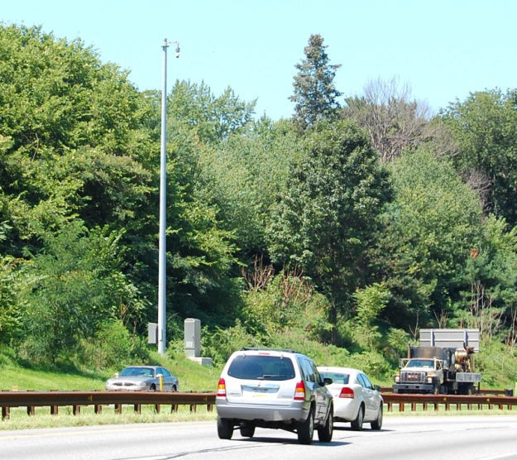
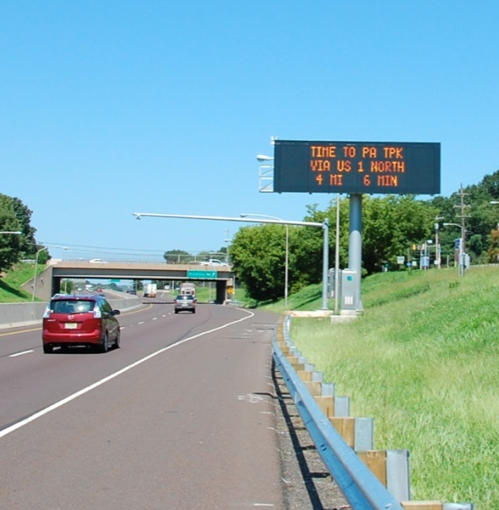
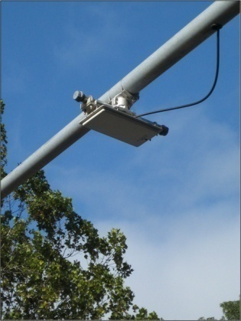
Freeway ITS
Video System
  Full view and end-to-end coverage of entire roadway
  Camera Lowering System
  Video Sharing – Cisco VSOM System
  All video provided to PA 511
Traveler Information System
  Full-size DMS deployments in advance of major interchanges and decisions points
  Travel time detections provided by
  E-Z Pass transponder sensors

Slide 20
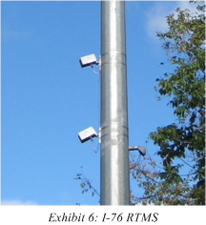
Freeway ITS (contd.)
Incident Detection System
  Sensor locations at approximately ½ mile intervals
  RTMS, loop, and video detection technology
  Private data used to supplement Dept. coverage
  All Purpose Incident Detection Algorithms used to alert operators to potential incidents

Slide 21
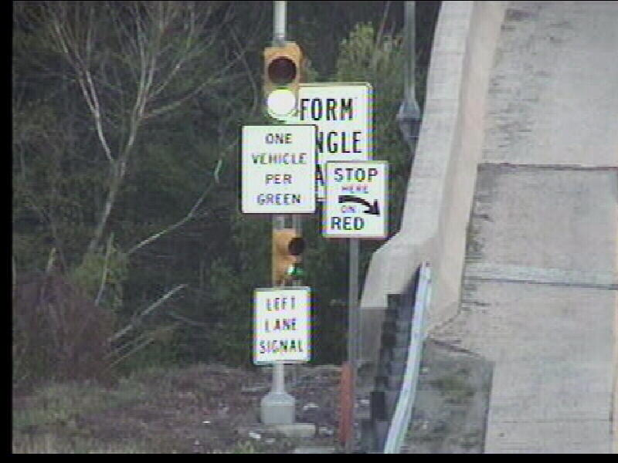
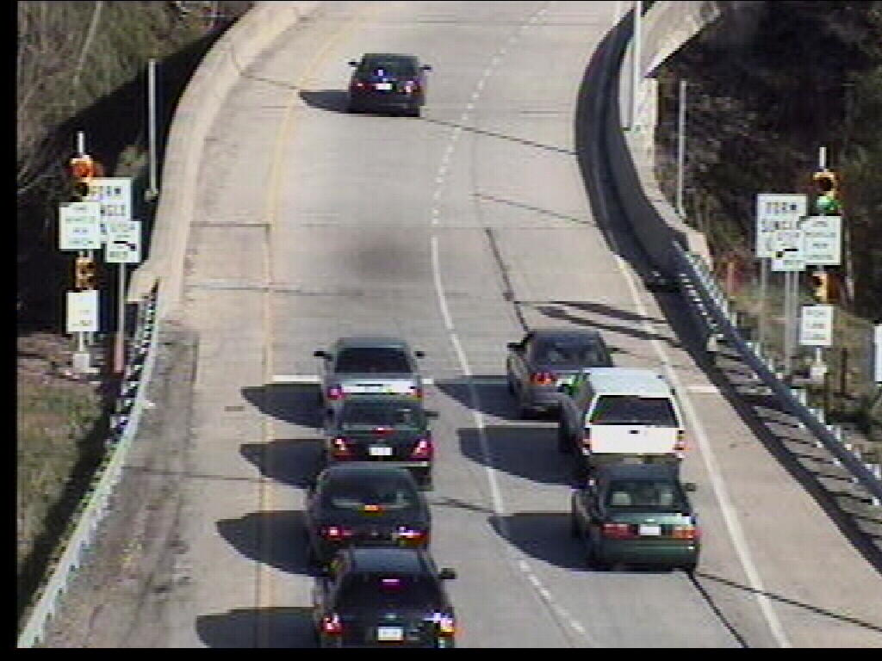
Ramp Meters
Currently operating at 9 locations on I-476
Designed to control flow of traffic entering the highway to ease congestion and
increase mainline speed.

Slide 22

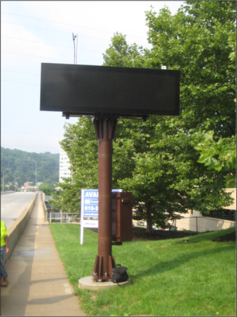
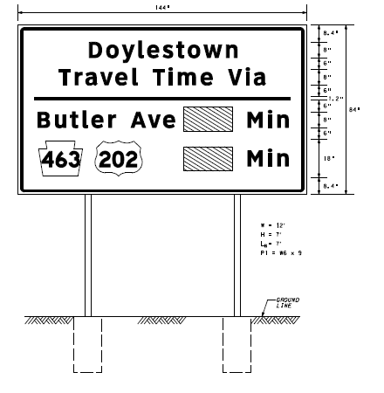
Arterial ITS
Video System
  Coverage at Critical Intersections and Approaches
  Analog and IP-based systems
  Video Sharing through VSOM system
  Co-located with Signal Mast Arms
Traveler Information System
  Smaller Size DMS
  Dual Static/Dynamic CMS
  Semi-Permanent DMS

Slide 23

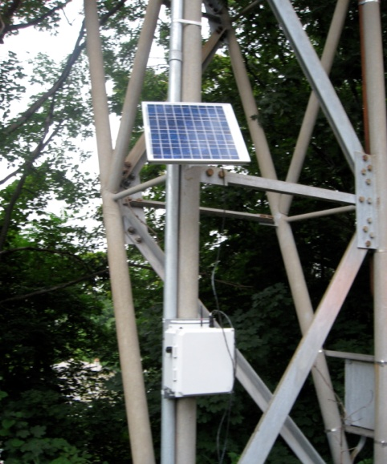
Arterial ITS (contd.)
Traffic Signal Systems
  Interconnection of signals and integration into regional communications network
  Monitoring and control capabilities from RTMC through central software platforms
Bluetooth Travel Time System
  Reads Bluetooth MAC addresses from on-board devices to track vehicles
  First deployment in Pennsylvania
  Small size and lower cost make for an effective arterial solution
  18 installations

Slide 24
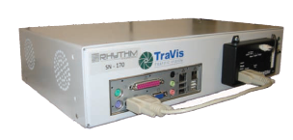
Adaptive Signal Control Systems
Rhythm InSync Implementations – approx. 50 intersections
  Self-Optimizing traffic signal processors
  Adapts to real-time situations and maximizes green time for heavy approaches
  Eliminates the need for signal retiming
  Cameras provide detection at all approaches

Slide 25
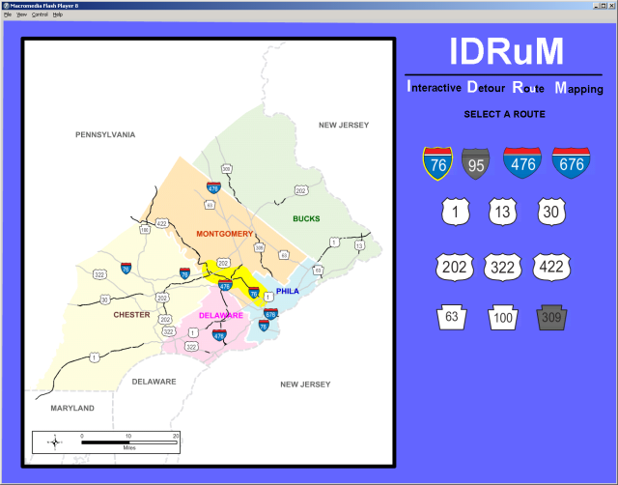
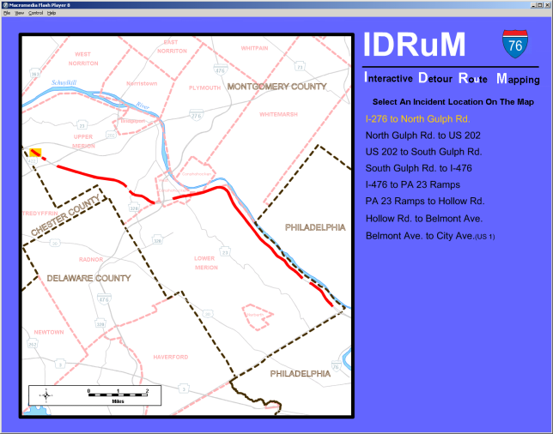
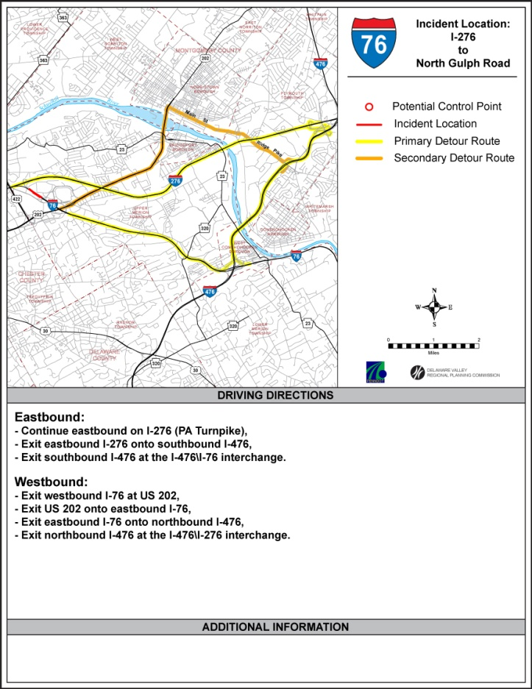
IDRuM – Interactive Detour Route Mapping
DVRPC effort to create an Internet application for accessing PennDOT detour routes
Step 1: Select Highway
Step 2: Select Incident Location
Step 3: View / Download / Print / dd Email Map
Formats Used:
Steps 1 & 2: Macromedia Flash
Step 3 (final map): Adobe PDF
Both formats are available for FREE download

Slide 26
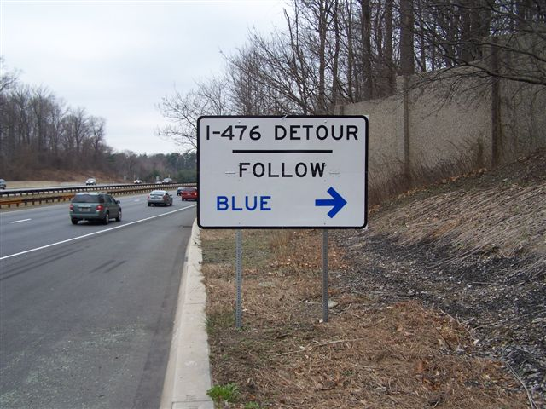

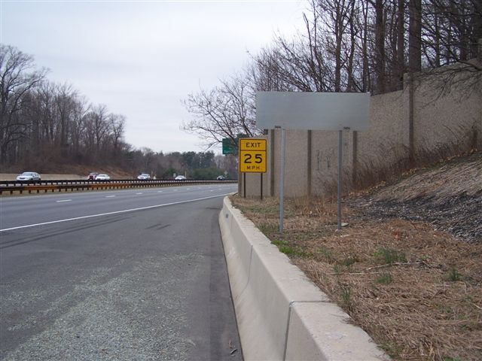
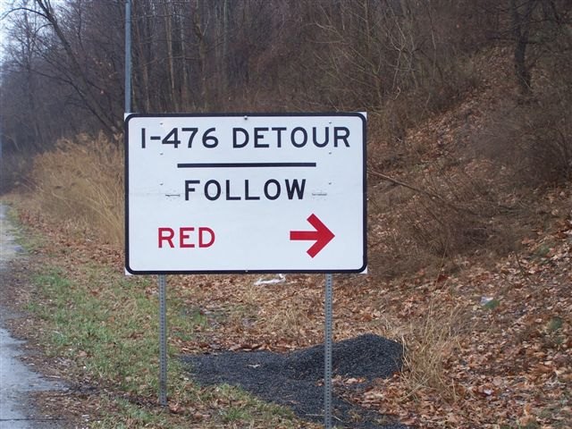
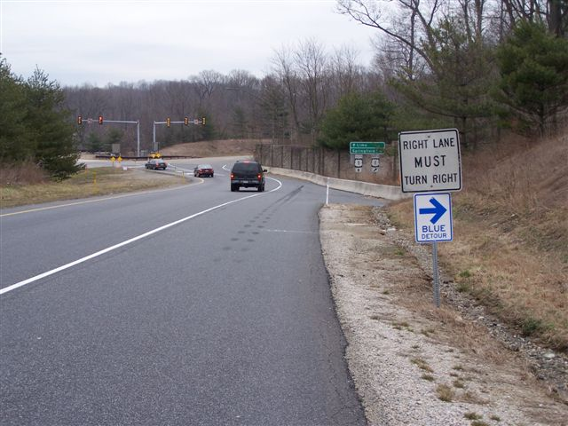

Slide 27
Video Sharing…
Partnering For Success
Partners have access to all PENNDOT CCTV images
Creates stronger communication links between Police dispatchers, the media, and other first responders.
Allows more immediate assessment of incident, allowing proper resources to be dispatched and directed.
Monitors traffic queues to create efficient traffic flow patterns around incidents.
Allows media outlets to provide true, real-time traveler information to TV viewers and radio listeners.
Real-time traveler information available through in-car navigation systems via Sirius and XM satellite radio systems.

Slide 28



Purpose of Incident Management
Task Forces
Improve Coordinated IM Response
Foster Interaction Among IM Stakeholders
Identify and Address Critical IM Needs
Give Other Organizational Perspectives
Notes:
28

Slide 29
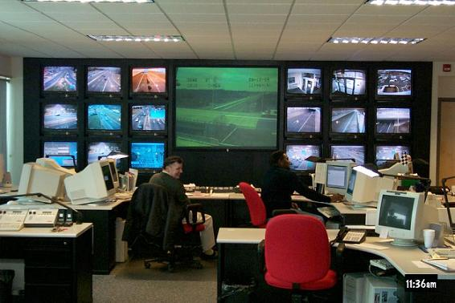
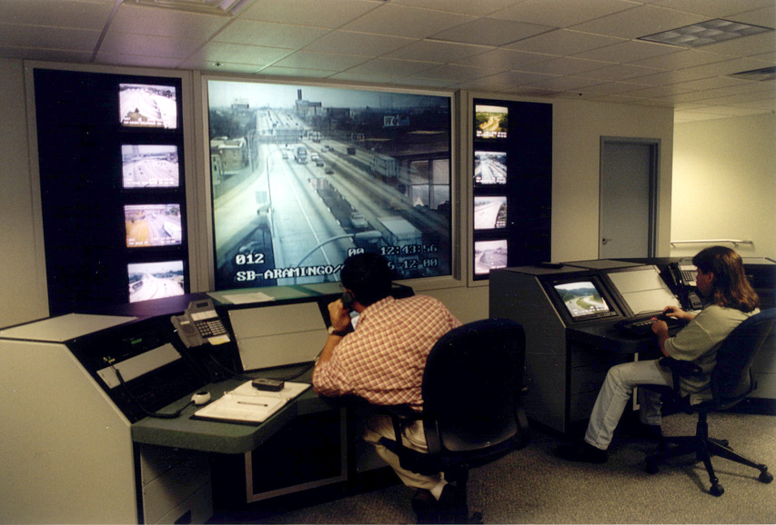
Inter-Agency Coordination
Build Relationships
Enhance Communications
Provide Forum to Discuss Issues
Share Resources
Coordinate event management with stadium authorities and Local Police.
Notes:
29
Duplicate Milepost Numbers

Slide 30
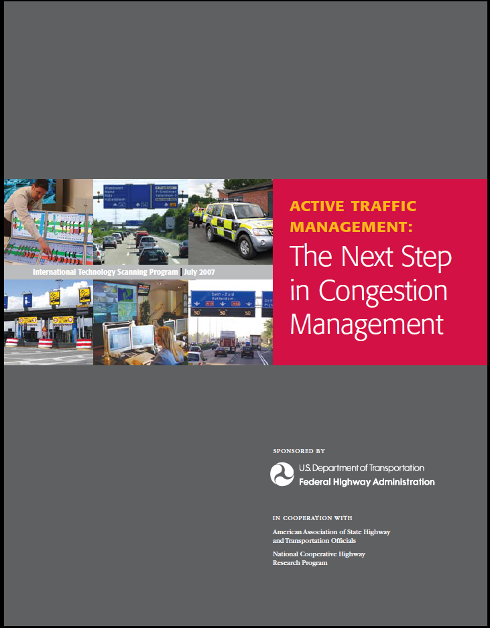
High Priority Future Initiatives
Expansion and integration of communications networks to provide for greater network security and redundancy
Migration to a digital video management and distribution platform
Investigation of Active Traffic Management tools along high-priority corridors
  Variable Speed Limits
  Ramp Metering
  Junction Control

Slide 31
Thank You!
PennDOT 6-0 RTMC Staff
Matt Miele – Freeway Management Section Supervisor
Frank Dijoseph – RTMC Floor Supervisor
Dave Wolfe – Traffic Control Specialist
Vahik Andonian – Traffic Control Specialist
Matt Elliott – Traffic Control Specialist
Manny Anastasiadis
Assistant District Traffic Engineer
for ITS and Traffic Operations
PennDOT Engineering District 6-0
Eanastasia@pa.gov
610-205-6590

Slide 32
Upcoming Deployments
2013 – 121 total new devices
  S.R. 0202, Section 7IT – 48 total devices
  S.R. 0202, Section 500 – 11 total devices
  S.R. 0202, Section 320 – 62 total devices
2014 – 8 total new devices and new ATMS
  S.R. 0422 ITS – 4 total devices
  S.R. 0202, Section 300 – 4 total devices
  Migration from Dynac to Statewide ATMS Software
2015 – 42 total new devices
  S.R. 0095, Section GR3 – 17 total devices
  S.R. 0063, Section ITS – 25 total devices
2016 – 141 total new devices
  S.R. 0095, Section GR1 – 81 total devices
  S.R. 0095, Section GR2 – 46 total devices
  S.R. 0202, Section 600 – 14 total devices
2017 – 62 total new devices
  S.R. 0095, Section CP2 – 62 total devices
5-Year Plan: 374 Programmed ITS Device Deployments, 450 signal enhancements
Planned signal and ITS capital expenditures of over $125Million

