Slide 1
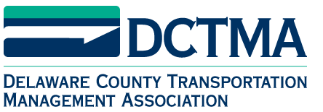
Governor Corbett’s
Transportation Plan
James D. Ritzman, P.E.
Deputy Secretary for Planning
March 21, 2013
Notes:
Overview of Governor Corbett’s plan to secure sustainable Transportation Funding

Slide 2
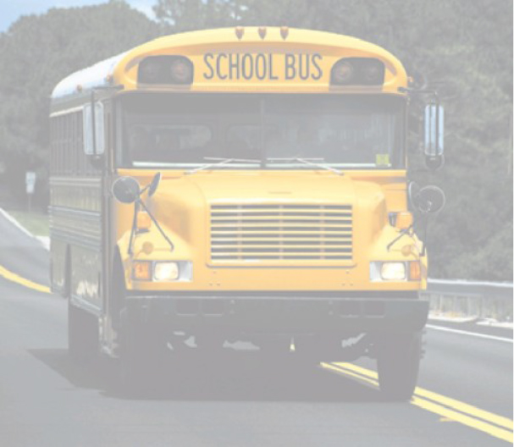
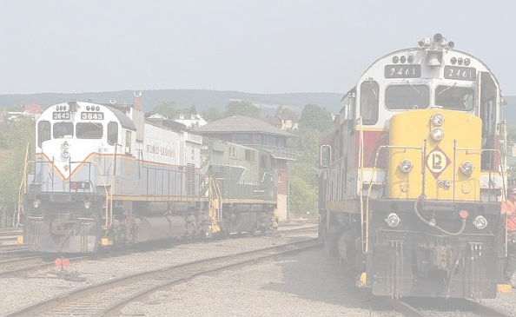
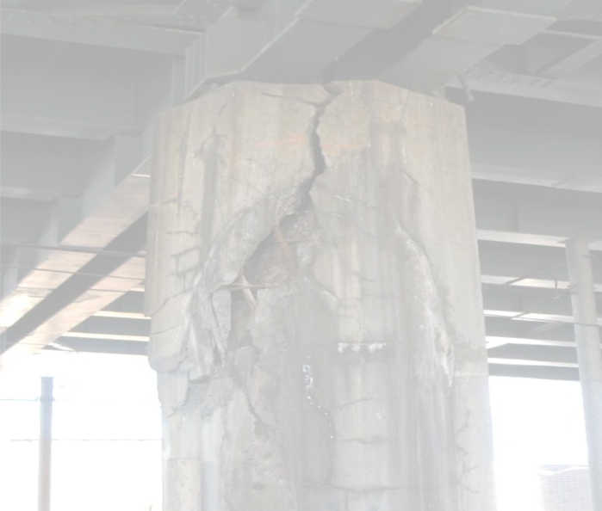
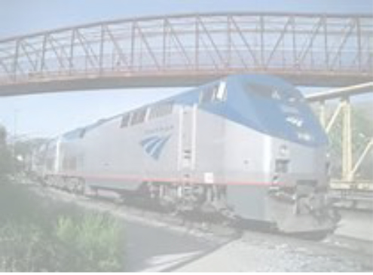
Transportation Goals in Pennsylvania
Public Safety | Commerce
1.5 million students travel by school bus daily
$500 billion worth of goods and services move annually
More than
4,000 structurally deficient bridges
1.4 million
Amtrak riders spare highways from congestion
Notes:
Safety for all
Posted bridge/closed bridges – typically travel on less “safe” roadways
Economic impact of longer transport distances
Transportation systems – ports, rail, aviation, and highways and transit

Slide 3
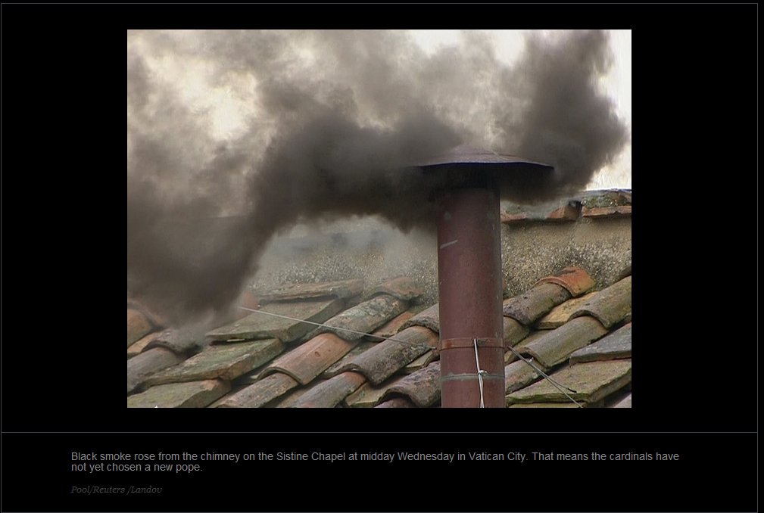

Slide 4
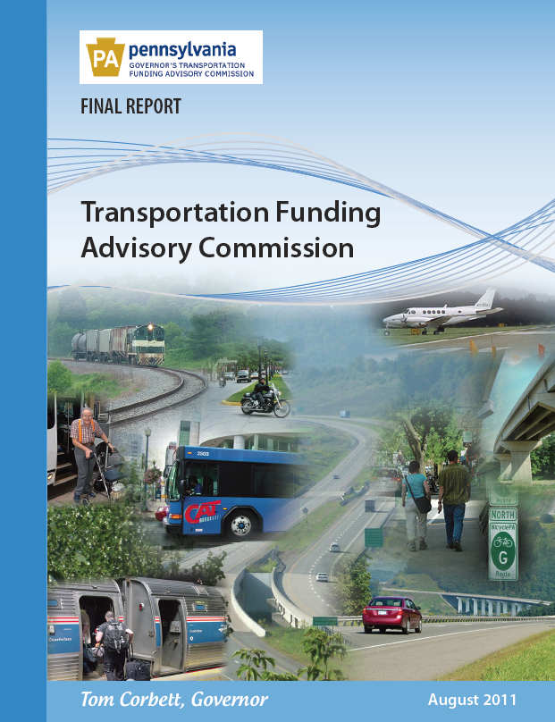
Transportation Assessments
Transportation Funding Advisory Commission Report (2011)
  Modernization
  Finance
  Legislation
  www.TFAC.pa.gov
Notes:
Focus on every $ currently received

Slide 5
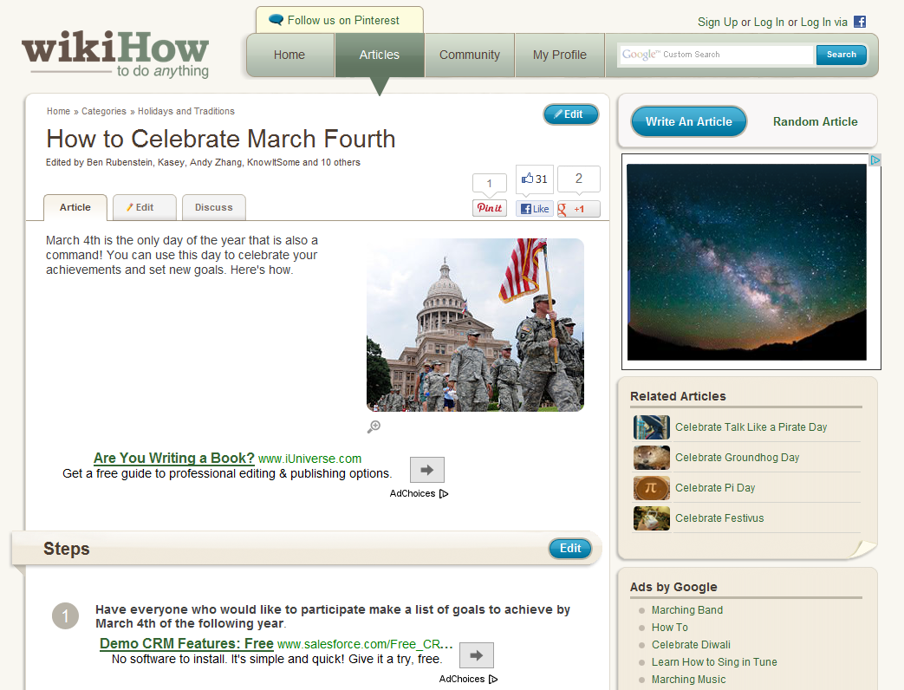

Slide 6
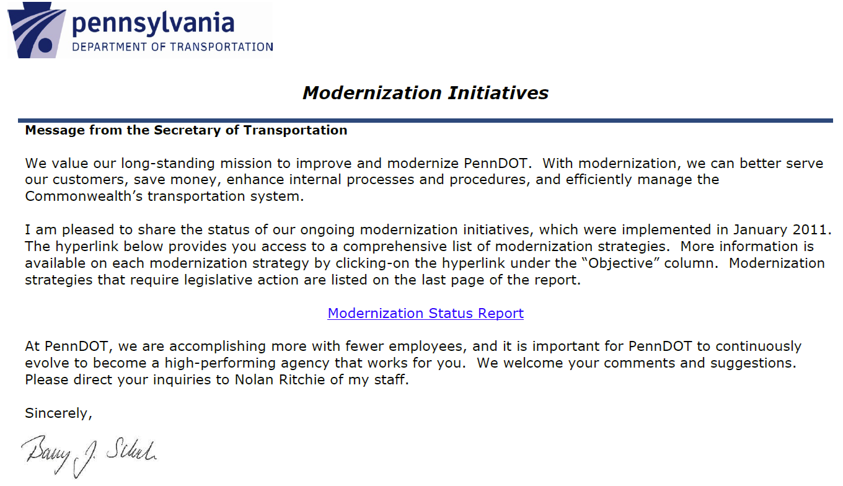
Modernization Initiatives
Notes:
39 modernization initiatives that do NOT require legislation
Pennsylvania Turnpike Commission
Develop Comprehensive Freight Movement Study
Electronic Highway Occupancy Permitting system
Idea Link
Outdoor advertising “compliance”

Slide 7
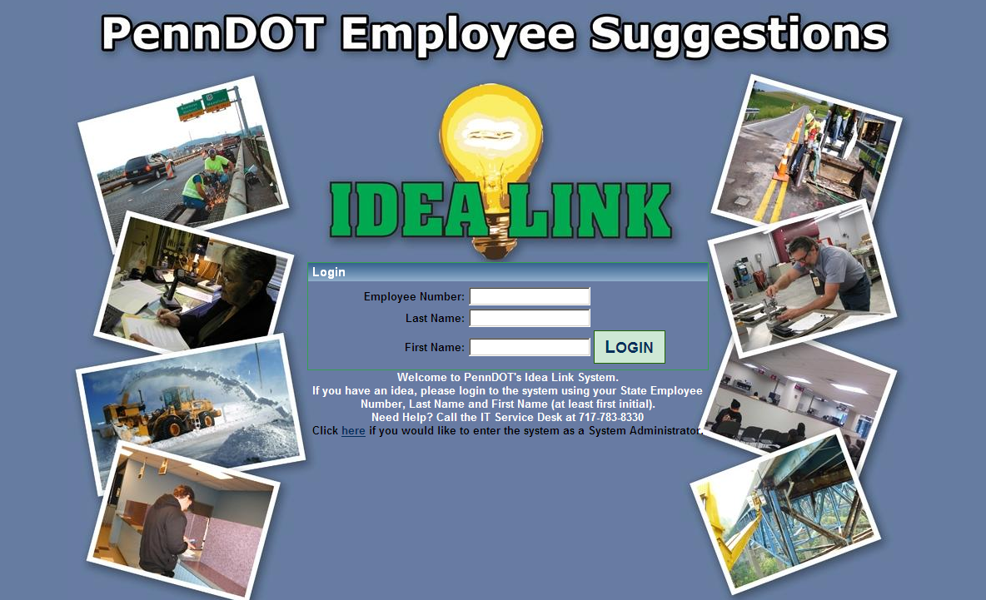
Idea-link
Notes:
737 submissions and 176 implemented to date

Slide 8
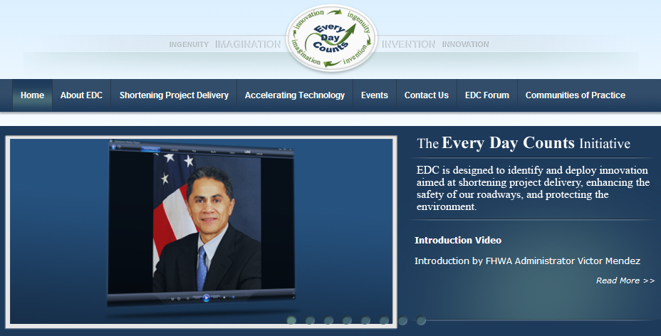
Every Day Counts Initiative
Notes:
Accelerating Technology and Innovation Deployment
Warm Mix Asphalt
Prefabricated Bridge Elements and Systems
Adaptive Signal Control Technology
Safety Edge
Geosynthetic Reinforced Soil
Shortening Project Delivery
Shortening Project Delivery Toolkit
Planning and Environmental Linkages
Legal Sufficiency Enhancements
Expanding Use of programmatic agreements
Use of In-lieu fee and mitigation banking
Flexibilities in R/W, Utility accommodation and relocation
Accelerated Project Delivery Methods
(Design Build, Construction Manager/General Contractor)

Slide 9
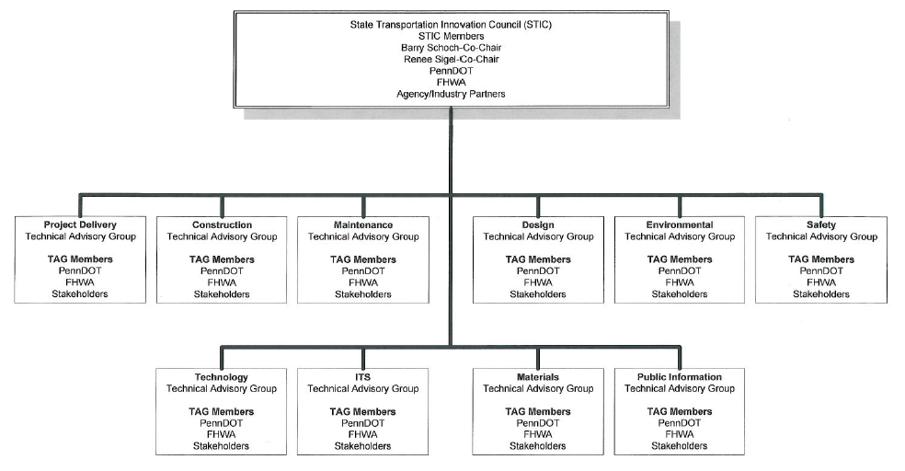
State Transportation Innovation Council
Notes:
Academia, industry, associations

Slide 10
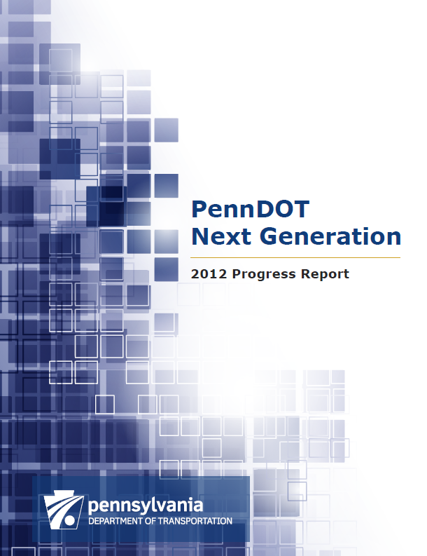
Transportation Assessments
PennDOT Next Generation Progress Report (2012)
  Modernization
  $50-70 million in annual cost-savings
  Stakeholder engagement
  www.ModernDOT.pa.gov
Notes:
Work more closely with other agencies - PTC, DCNR, DEP
Improve efficiency, better service @ less cost
EAGLE – ATV licensing

Slide 11
Transportation Investment

Slide 12
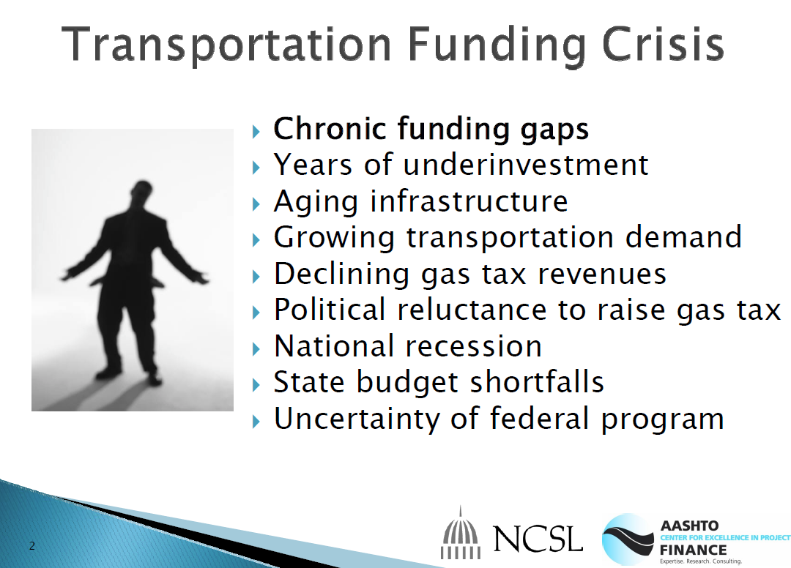

Slide 13
Transportation Improvement Program
Base Program
2009 – 2012 | $9.221 Billion
2011 – 2014 | $8.045 Billion
2013 – 2016 | $6.905 Billion
Current Program under development is less than 75% of 2009 Program.
Notes:
Precarious, Fragile System

Slide 14
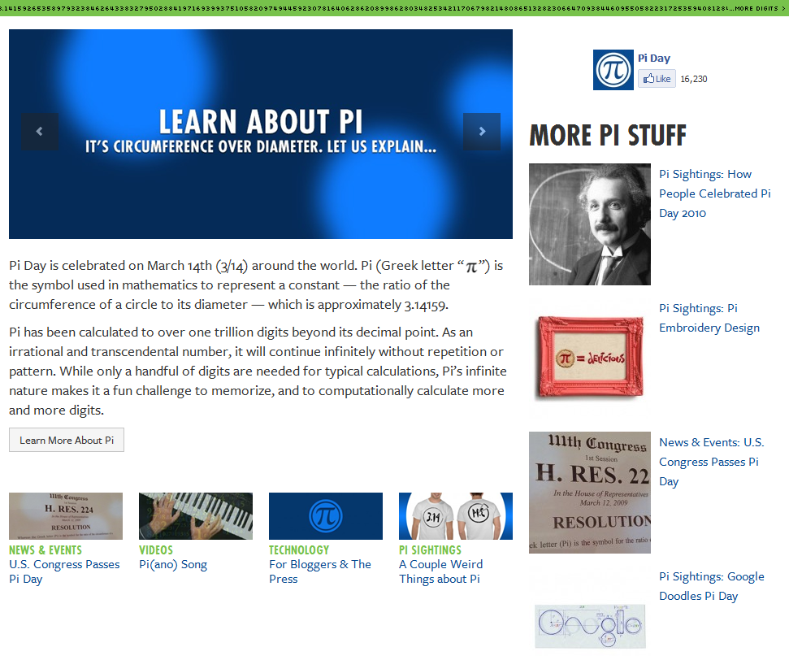

Slide 15
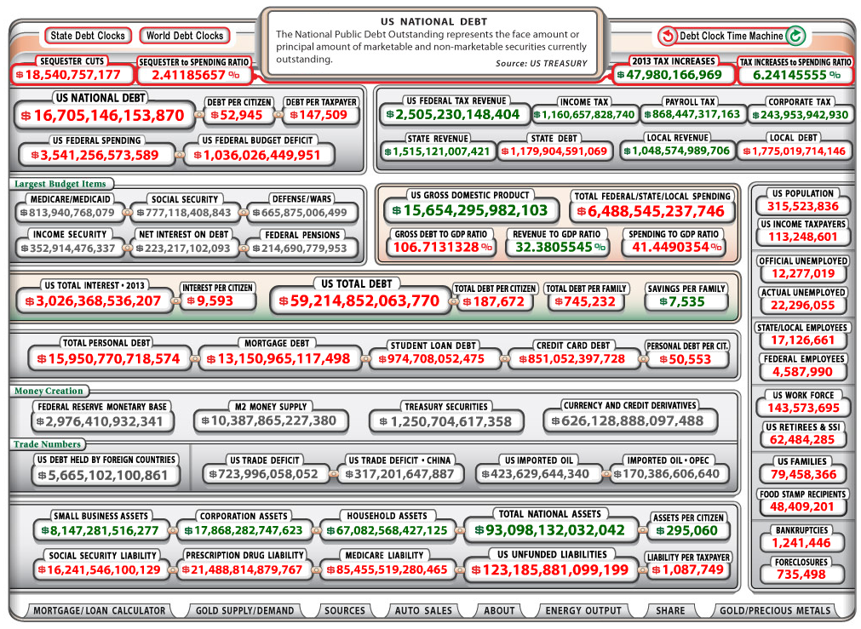

Slide 16
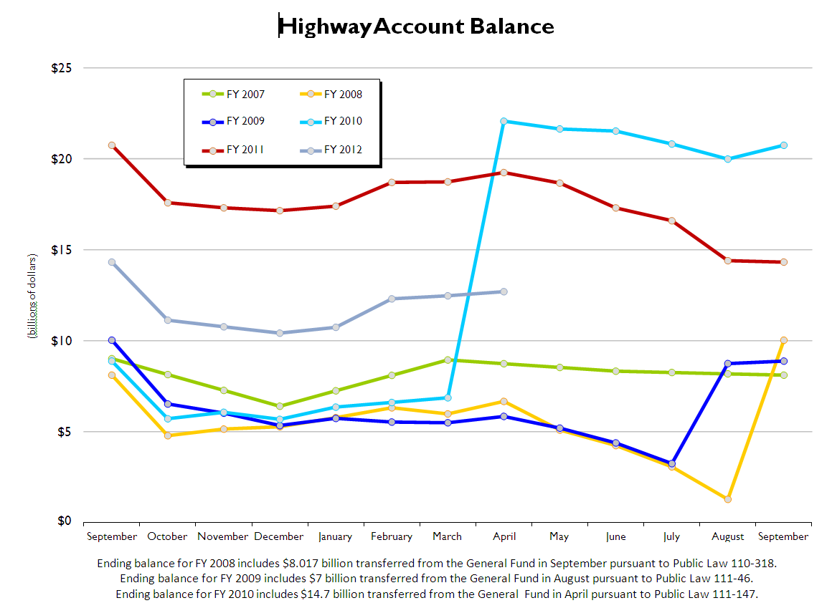
Notes:
FFY 2014 – Highway Trust Fund projected to be insolvent at end
$29 billion

Slide 17
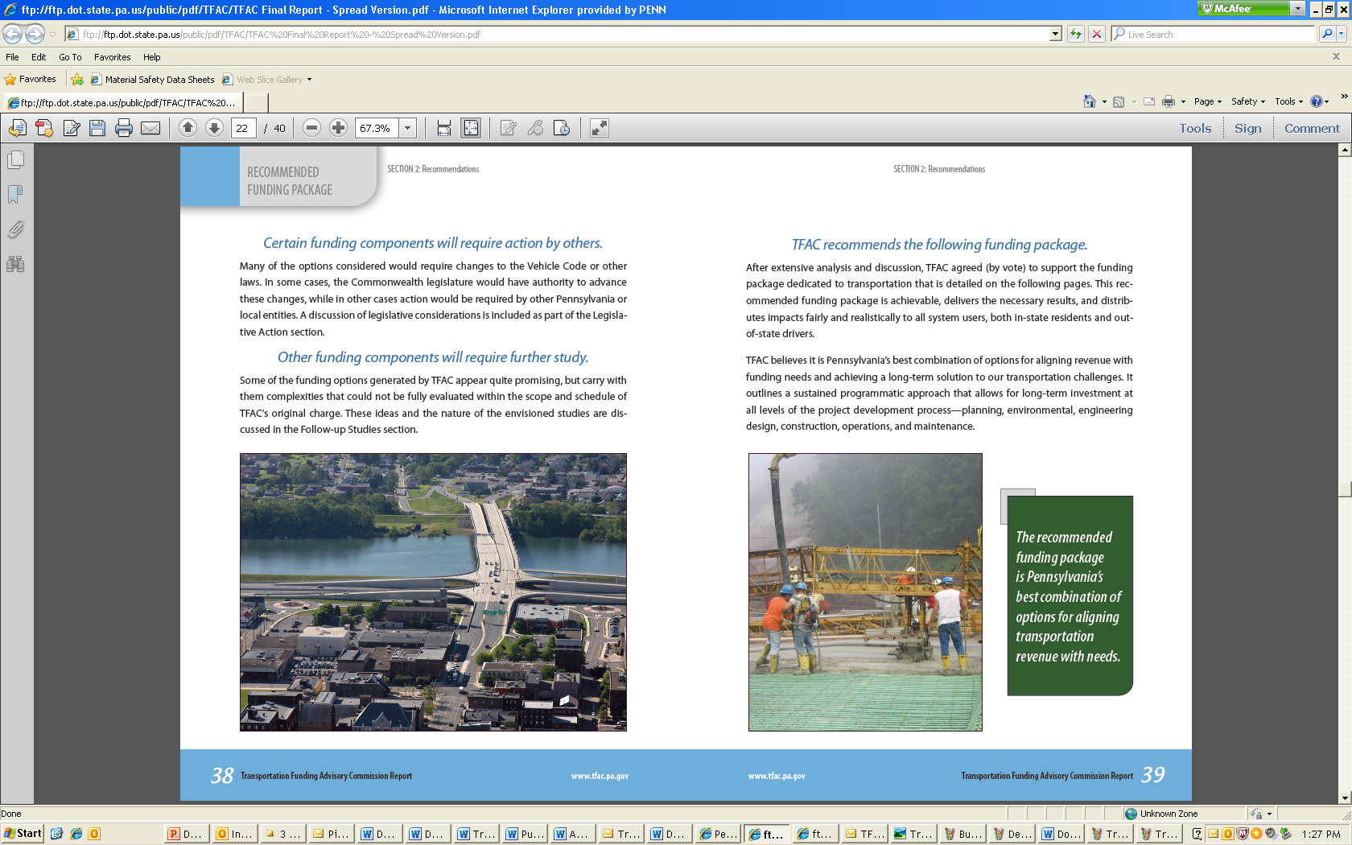
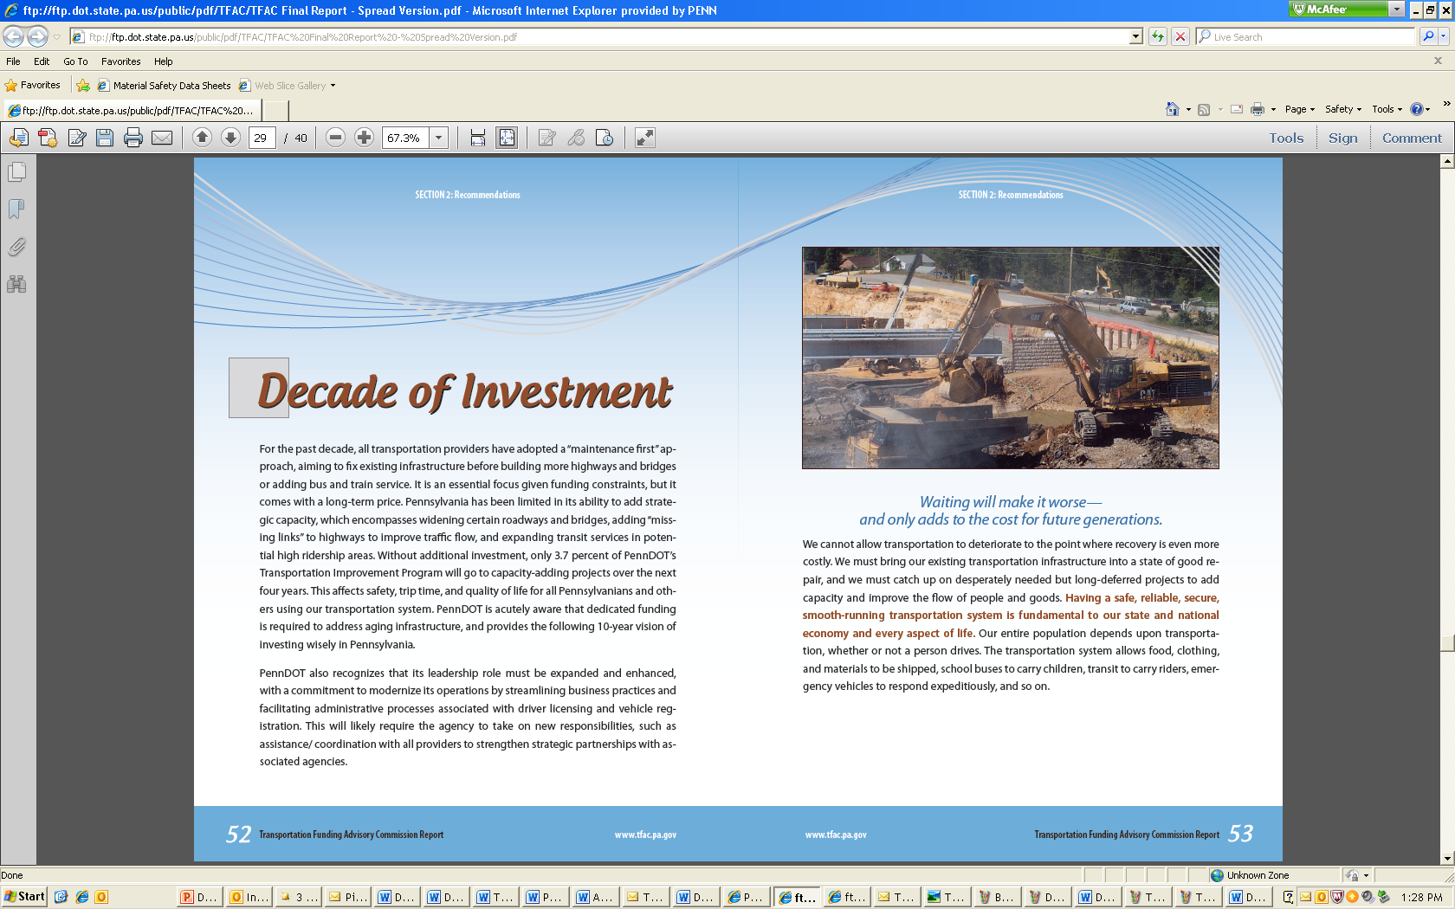
Governor Corbett’s Transportation Plan
Financial Components
Decreases the flat tax by nearly 17 percent
Generates $1.8 billion by Year 5
Utilizes the Public-Private Transportation Partnership Board
Ends contributions from the PA Turnpike in 10 years
Notes:
Gradually deregulates the OCFT
Competitive opportunity we didn’t have previously…
unsolicited proposals to be received in May

Slide 18
Governor Corbett’s Transportation Plan
Five-Year Financial Components
Timeframe | Finance Action
Year 1 | Uncap first one-third of OCFT Cut $0.01 from flat tax
Year 2* | Cut $0.01 from flat tax
Year 3* | Uncap second one-third of OCFT
Year 4 | No finance action
Year 5 | Uncap final one-third of OCFT
*Potential use of bond financing in Years 2 and 3.

Slide 19
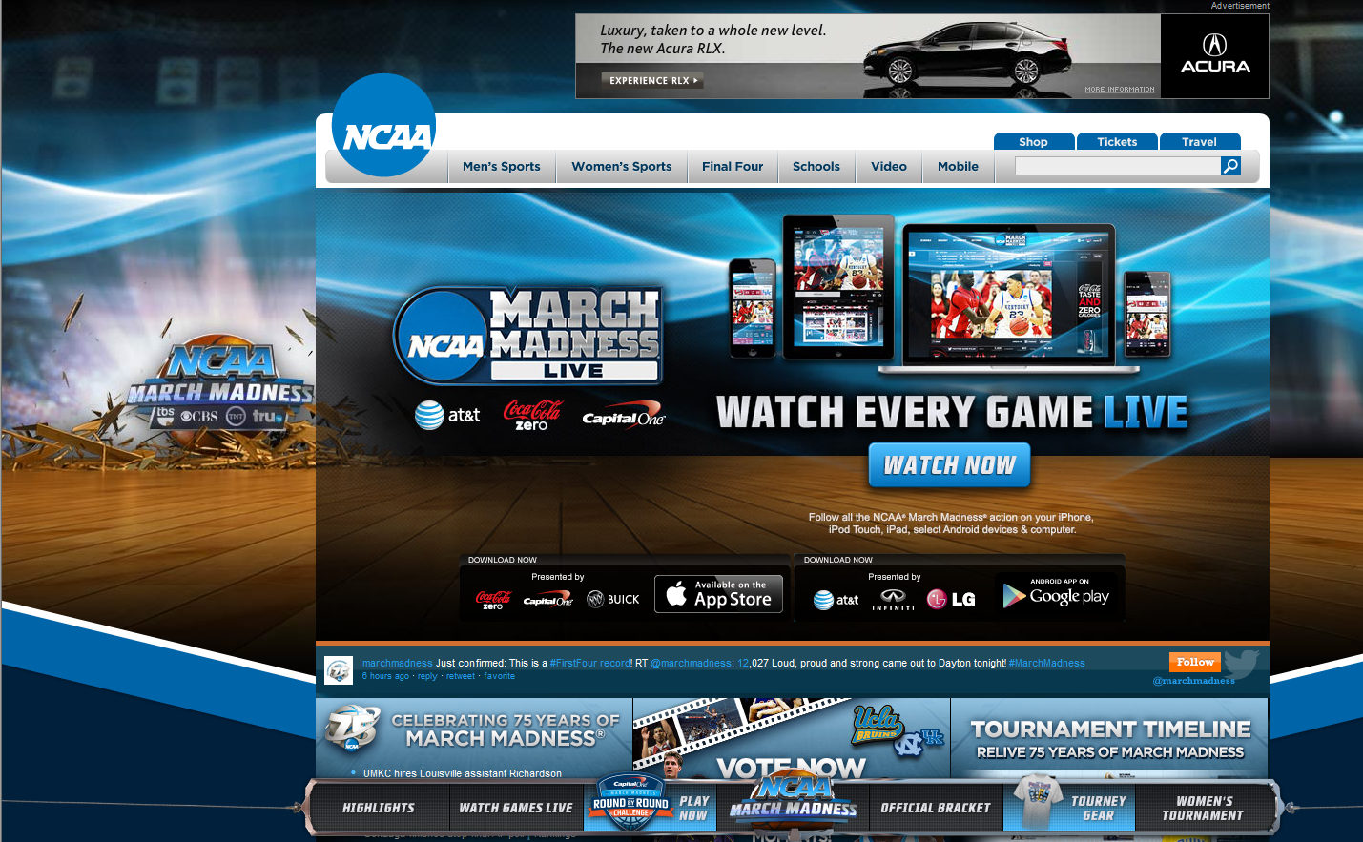
Notes:
19

Slide 20
Governor Corbett’s Transportation Plan
Investment Component*
Transportation Mode | Investment by Year 1 (est.) | Investment by Year 5 (est.)
State Roads and Bridges | $310 million | $1.2 billion
Public Transportation | $40 million | $250 million
Local Roads and Bridges | $70 million | $200 million
PA Turnpike Expansion Projects | $30 million | $85 million
Multi-Modal Fund | $60 million | $80 million
TOTAL | $510 million | $1.8 billion
*Based on the current wholesale value of gas.

Slide 21
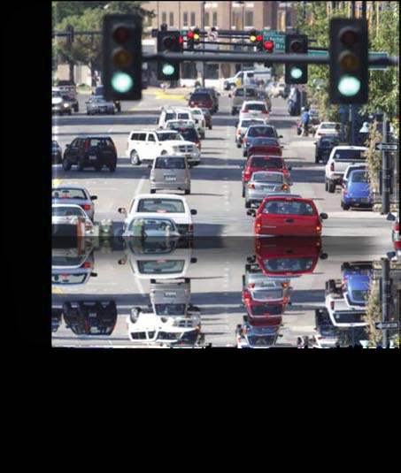
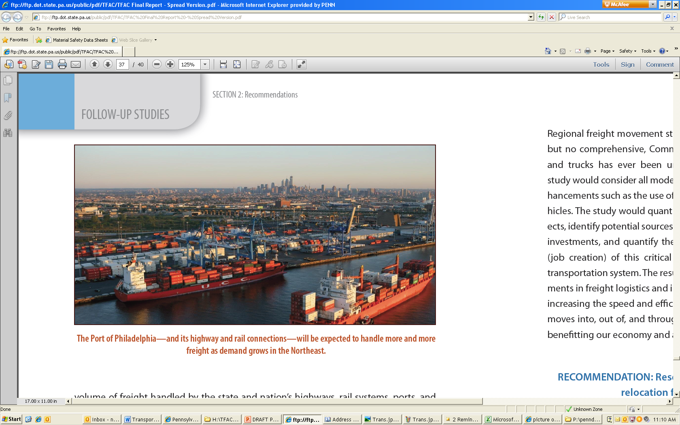
Governor Corbett’s Transportation Plan
Modernization Component
Enhance customer service
  2-year registration
  6-year driver’s license
Improve public transportation
Invest in local roads and bridges
Create a Multi-Modal Fund
Continue PennDOT Next Generation Initiative
Notes:
Improve Public Transportation
requiring consolidation studies, eliminate duplicative administrative overhead costs, 3.33% to 20% capital, 15 to 20% operating
Local Bridge pilot (Blair, Luzerne, Westmoreland)
if bundleable – from 20% to 0%, if not…go to 30%
Multi-modal Fund – TIP planning, reducing the cost of overhead; invest in local roads up to 50% (rail example)
Keep pushing the envelope…with EVERY $ seeking best practices...can’t stress this enough!

Slide 22
Cost of Inaction
Annual Construction Lettings
New Funding
Current Funding
Note: The sharp rise in 2009 is attributed to the American Recovery and Reinvestment Act.

Slide 23
Cost of Inaction
Impact on State-Owned Structurally Deficient (SD) Bridges
More SD Bridges
New Funding
Fewer SD Bridges
Notes:
Cost of Inaction – you will be paying more AND more

Slide 24
Cost of Inaction
Impact on Roughness of State-Owned Highways
Rougher Roads
Current Funding
New Funding
Smoother Roads
*IRI: International Roughness Index
Notes:
“painting bad wood”

Slide 25
Pavement Reconstruction
Notes:
Interstates, NHS and >2000ADT is half our system at 20,000 miles expected to last 40 years when it was built more than 40 years ago, we now expect longer life. To prevent more from passing the 40 year mark, we must reconstruct 500 miles per year = 20,000 miles / 40 years. In the past 20 years we have fallen well short of this need and the focus on bridges more recently has nearly ended the pavement reconstruction program.

Slide 26
Notes:
Our Transportation Improvement Program reflects this focus as we have reduced the number of capacity adding projects over the past three updates. Though we know we need to build capacity adding projects in certain places across the state to reduce congestion, we also have a network of over 40,000 miles of roadway and 25,000 state-owned bridges that are in need of repair, and we are committed to fixing the existing system.

Slide 27
Investing in Pennsylvania
Enhance safety for all Pennsylvanians
  31,000 registered school buses
  1.5 million students travel by school bus daily
Sustain interstate economic competitiveness
  $500 billion worth of goods and services move annually
Improve mobility and customer service
Create 50,000 jobs as opposed to inducing 12,000 job losses
Notes:
Website and Decade of Investment

Slide 28
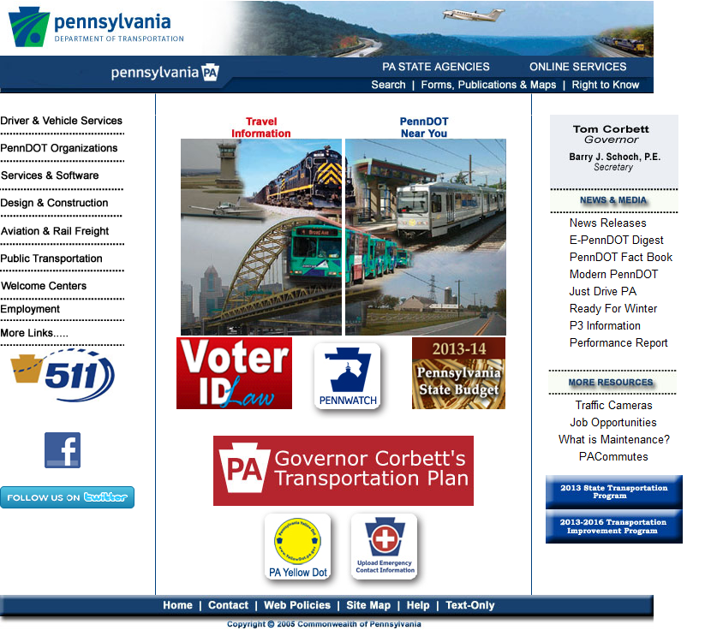
Just so you know…

Slide 29
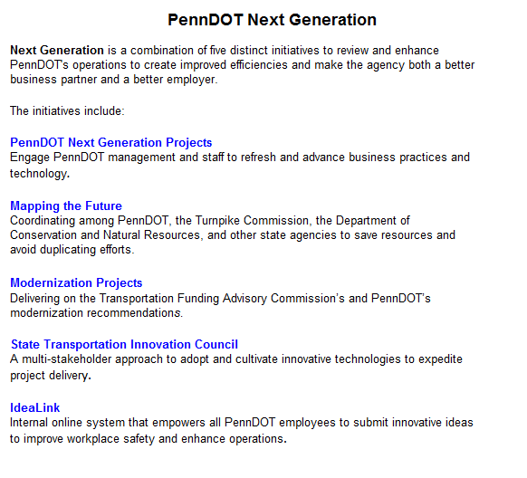
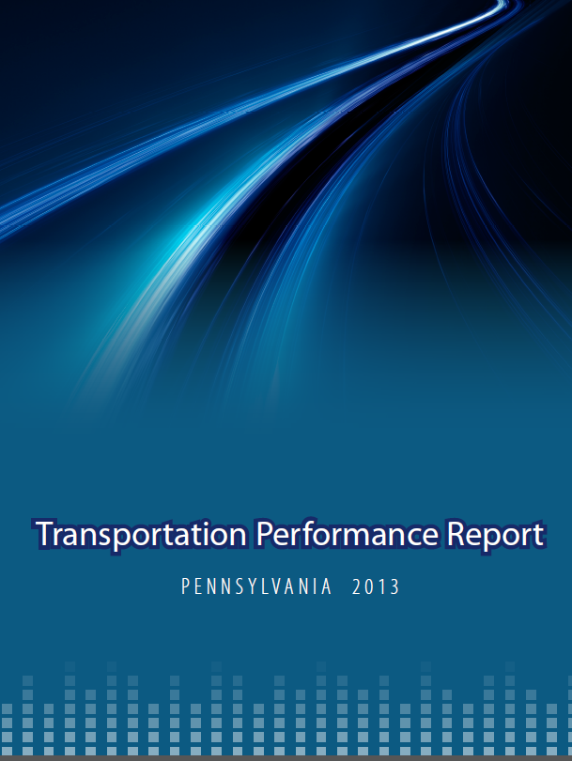
Just so you know…

Slide 30


Slide 31
